Slide 1


Slide 2
February 2016 - Alliance Workshop
St. Louis Regonal Freightway Alliance
Needs Analysis and Freight Development Committee
Terminal Rail Association of St. Louis – President Mike McCarthy
Marketing Committee
America’s Central Port - Executive Director Dennis Wilmsmeyer
Policy Committee
MO Baptist University - Dean of Graduate Studies Dr. Ed Hillhouse

Slide 3

Freight Development Project List
Primary Criteria
Economic Impact
Multimodal Impact
Efficiency Impact
Secondary Criteria
Strategic Alignment
Business Development Impact
Public Safety

Slide 4
SELECTED PROJECTS
Merchants Rail Bridge Replacement
126-year old rail bridge that spans the Mississippi River
Connections to six Class I railroads
Currently carries more than 40 million gross tons annually
Total estimated project cost = $222 million
Interstate 270 Mississippi River Bridge Replacement
Replacement of two existing structures
Construction of new structure to accommodate forecasted vehicle/freight flow
Total estimated project cost = $160 - $175 million
Highest Priority

Slide 5
SELECTED PROJECTS
Interstate 270 Improvements
Increase capacity by widening to six lanes from Lilac Ave. to IL-111
Estimated cost = $350 - $400 million
Corridor improvements between Lilac Ave. to Lindbergh Blvd.
Estimated cost = $243 million
North Riverfront Commerce Corridor Improvements
Improve mobility and circulation issues in 3,000 acre multimodal logistics and business district
Total estimated cost = $55 million
Highest Priority

Slide 6
SELECTED PROJECTS
Relocate IL Route 3 in St. Clair County, Illinois
Improve access to I-70, Stan Musial Veteran’s Memorial Bridge, Sauget Industrial Park and St. Louis Downtown Airport
New construction between East St. Louis and Sauget
Estimated cost = $125 million (two lanes) or $170 million (4 lanes)
Falling Springs Diversion Loop/IL Route 3 Railroad Bypass
Construction of bypass loop from IL Route 3 over A&S railroad in Sauget to eliminate substantial through-traffic delays
Total estimated cost = $20 - $25 million
Highest Priority

Slide 7
FUNDING OPPORTUNITIES
FASTLANE
Freight Network Study – East West Gateway
Merchants Bridge - Public-private partnership
Bi-State Development Terminal Railroad Association MoDOT
Interstate 270 improvements – MoDOT
TIGER Grant

Slide 8
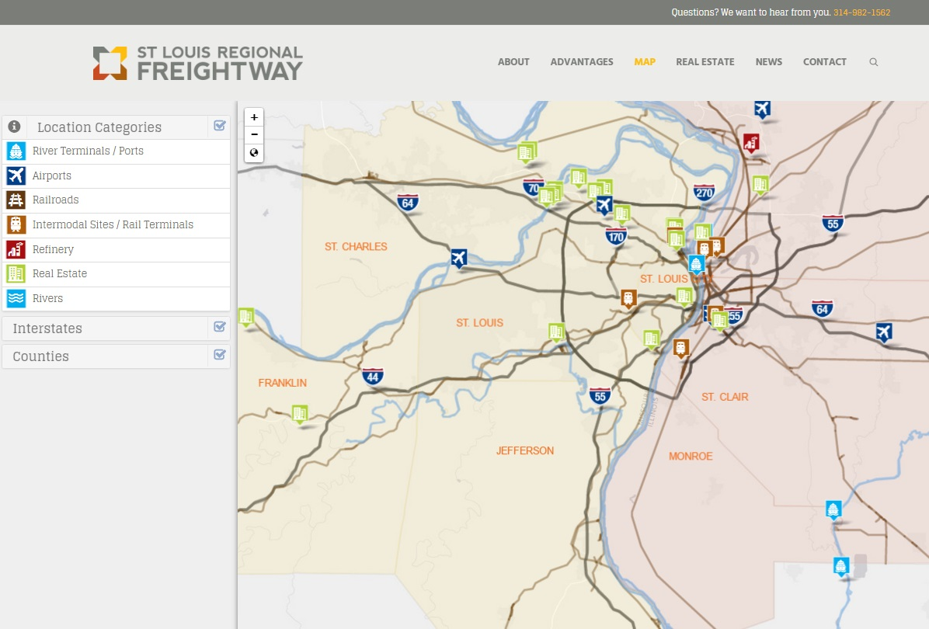
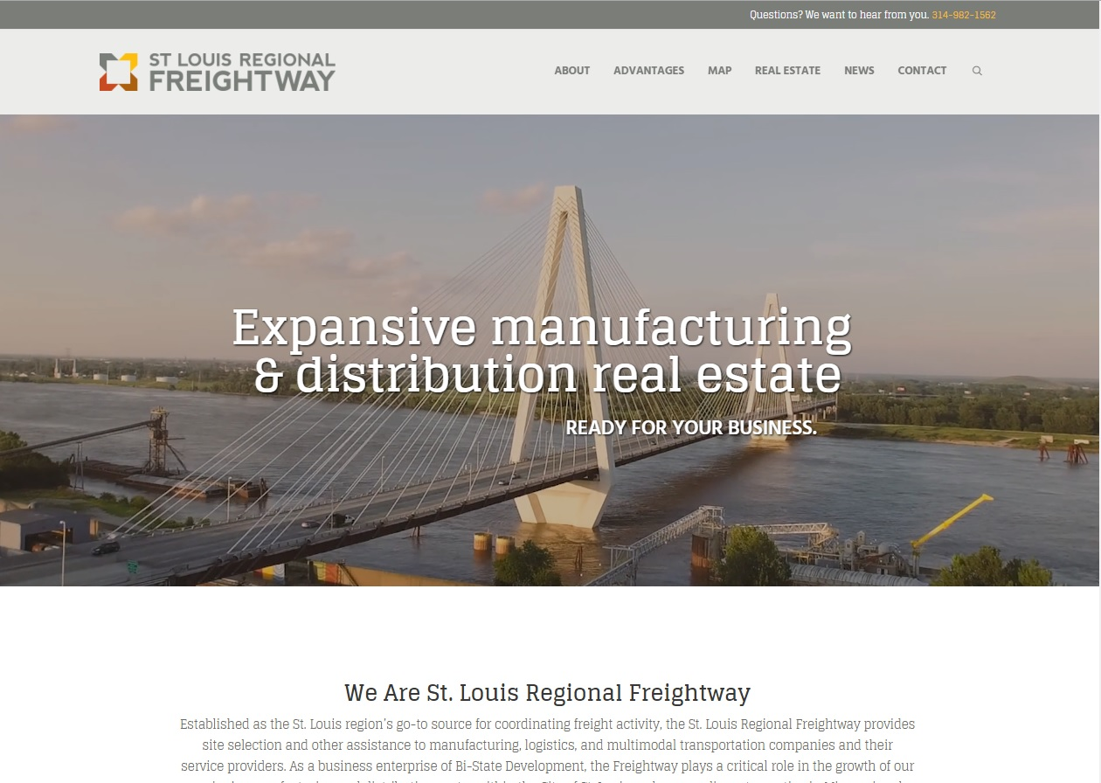
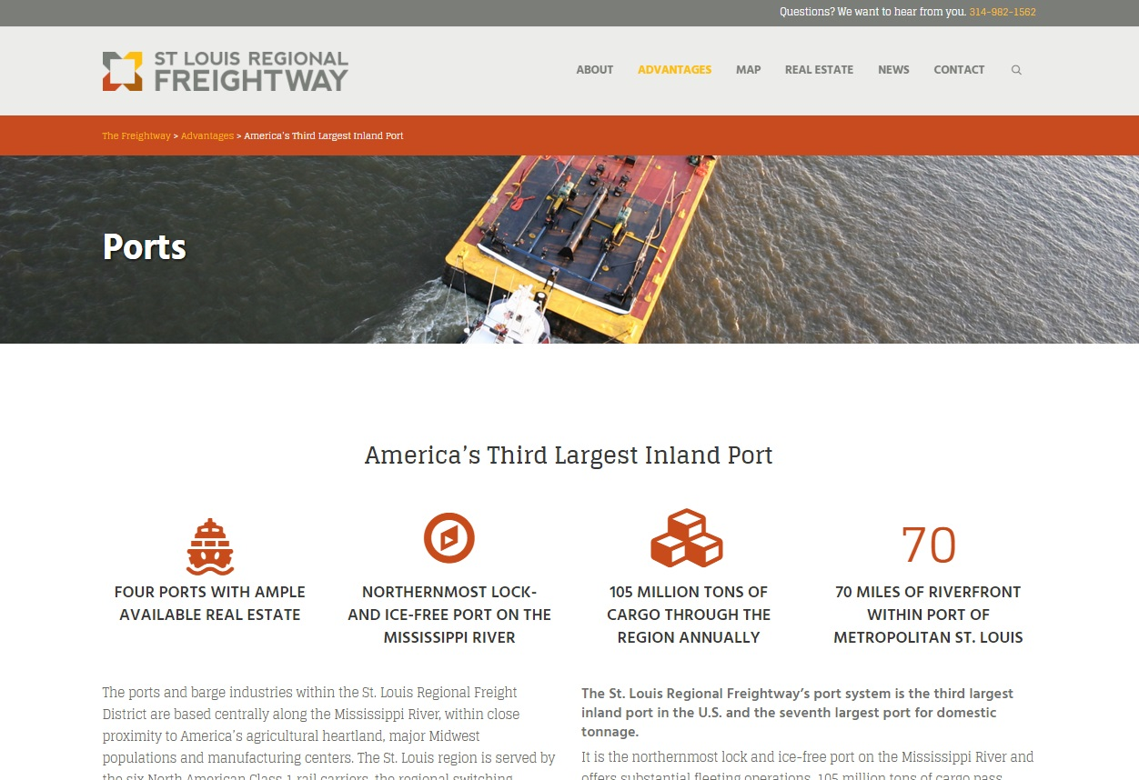
REGION’S DIGITAL PRESENCE
TheFreightway.com is our front door for attracting businesses, investors and real estate speculators to the region
The fact sheet and comprehensive real estate resource are tools for the entire region

Slide 9
April 2016
April 27th 2016 – Freight Summit
  Keynote speaker – Federal Highway Administration Administrator Gregory Nadeau
  Release website

Slide 10
Moving Forward
Working Group Committees
  Container on Barge – Viable alternative
  Truck Drive Workforce Initiatives
  Real Estate – Brokers and Developers
Develop and build partnerships with other regions that can benefit the region’s freight and manufacturing investment. (Mid-West Coalitions, New Orleans, Houston, Columbus)

Slide 11
Moving Forward
Summer 2016
  USACE – St. Louis Harbor Fleeting Plan
    Public/Private Partnership
    Identify future fleeting capacity needs and likely locations of expansion
    Coordinate dredging program with the private industry.
  Finalize Key Performance and Financial Plan
  Meet with Congressional Delegation and National Industry Organizations for freight funding.
  Website – Industry directory
  Public and private river terminals and docks?

Slide 12
TheFreightway.com
Directory
NAME ‐ SCF Marine
River Mile and Bank ‐ 167.5 Right
Operator ‐ John Smith
Owner ‐
Contact ‐
Phone ‐
Email ‐
Public Access ‐ No
Rail Access ‐ Yes
Dry Goods ‐ Yes
Liquids ‐ Yes
Liquids and Dry Goods ‐ No
Other uses ‐ ‐
Website

Slide 13
MCLamie@TheFreightway.com TheFreightway.com

Slide 14
  Next Port Working Group Meeting

