Slide 1

St. Louis Regional Freightway
Port Working Group Meeting
Wednesday, January 17, 2018

Slide 2
Matt Freix
Operations of DNJ Intermodal Services – St. Louis and Minneapolis
Mary Lamie, PE
Executive Director, St. Louis Regional Freightway
Notes:
MoDOT

Slide 3
Update on MoDOT Infrastructure and the North St. Louis Riverfront Commerce Corridor Partnership

Slide 4
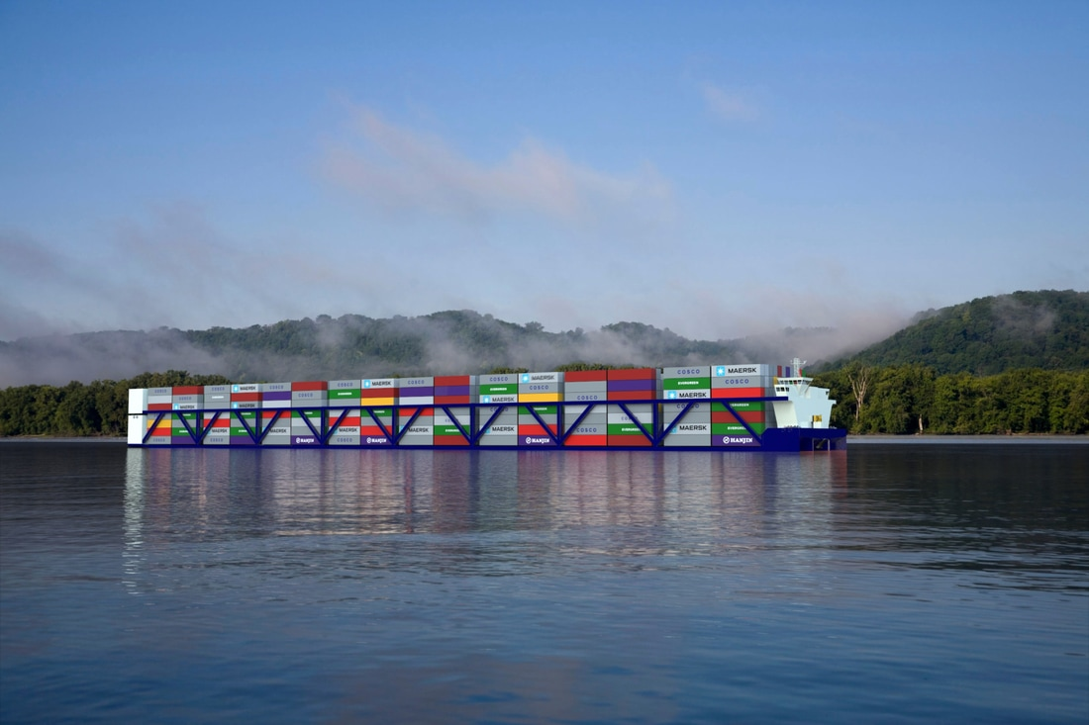
Updates - Container on Vessel
Memorandum of Understanding - January 2018
Jefferson County Port
Authority American Patriot Holdings
Port of Plaquemines

Slide 5
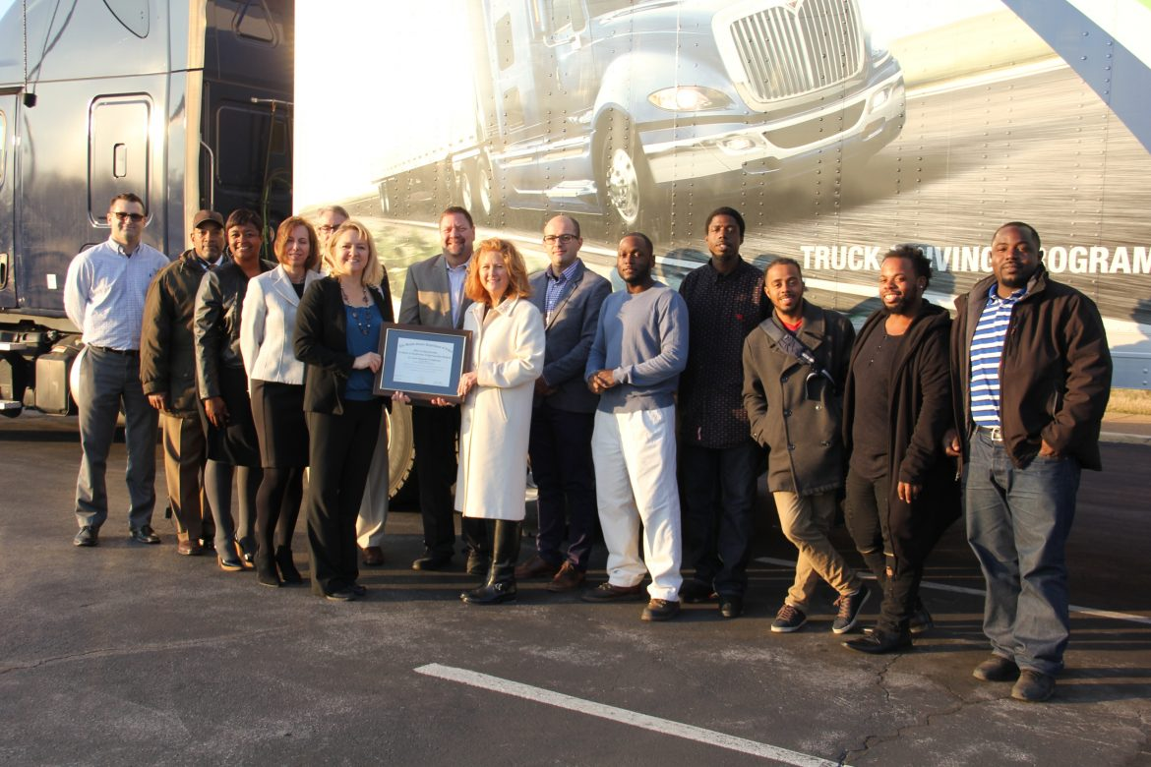
Updates – Pilot Truck Driver Apprenticeship Program
Public – Private Partnership - November 2018
U.S Department of Labor
TransPORTs
St. Louis Agency on Training and Employment (SLATE)
St. Louis Community College
Hogan Trucking Transportation & Logistics
Vega Transport
Schneider Trucking

Slide 6
Updates - 2017 Project Overview
$2 Billion Multimodal Transportation Project List
Improving the Multimodal Transportation Network
Access to the Multimodal Transportation Network
Merchants Bridge (TRRA) Replacement over the Mississippi River (MO-IL)*
I-270 Improvements from Lindbergh Boulevard to IL Route 111 (MO-IL)*
Union Pacific Railroad Lenox Tower Replacement (IL)
St. Louis Lambert International Airport North Cargo Improvements (MO)
I-70 Improvements from I-64 Interchange (MO) to Stan Musial Veterans Memorial Bridge
America’s Central Port Improvements (IL)
MidAmerica St. Louis Airport Distribution Improvements (IL)
J.S. McDonnell Connector Access Improvements (MO)
I-64 Improvements from Green Mount Road to Illinois Route 158 (Air Mobility Drive) (IL)
Kaskaskia Regional Port District Improvements (IL)
North Riverfront Commerce Corridor Improvements (MO)*
Illinois Route 3 Access Improvements (IL)*
I-255 / Davis Street Ferry Road Interchange (IL)
I-255 / Fish Lake (Ramsey Road) Interchange (IL)
I-70 St. Louis County Improvements from Natural Bridge Road to Hanley Road (MO)
St. Louis Lambert International Airport Access Improvements (MO)
Mississippi River Port Development Projects (MO)
Illinois Route 158 (Air Mobility Drive) Expansion from Route 161 to Route 177 (IL)
North Park Access Improvements (MO)
Earth City Access Improvements (MO)
*Projects in bold indicate the St. Louis Regional Freightway’s highest priorities in 2017.
Notes:
Mary Lamie
Improving the Multimodal
Transportation Network

Slide 7
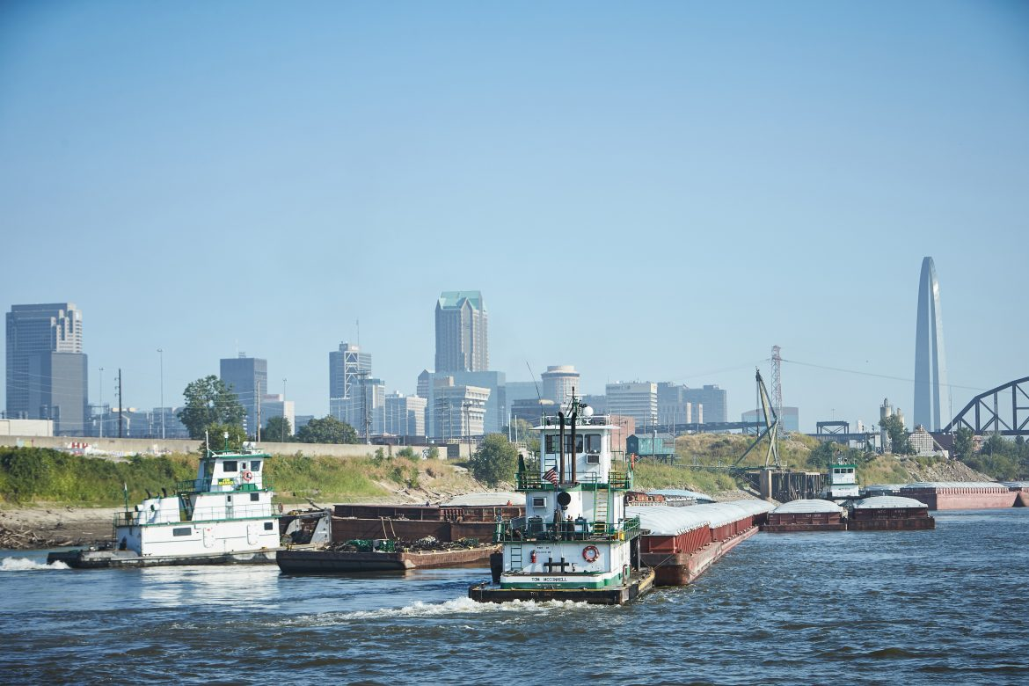
Updates - 2017 Freight Development Committee
Advocating for Infrastructure Investment
Freight Development Committee advocates to elected officials and industry leaders:
Congressional Delegation Meetings
EWGCOG Board of Directors Approval
U.S. Department of Transportation
Media Coverage – Building awareness
IL Freight Advisory Council and IL State Senate Hearing
MO Transportation Task Force and MHTC
Notes:
Congressional Delegation meetings – Mike McCarthy
E-W Gateway, USDOT, IL Freight and MO – Lamie
Media Coverage – Ted Zimmerman

Slide 8
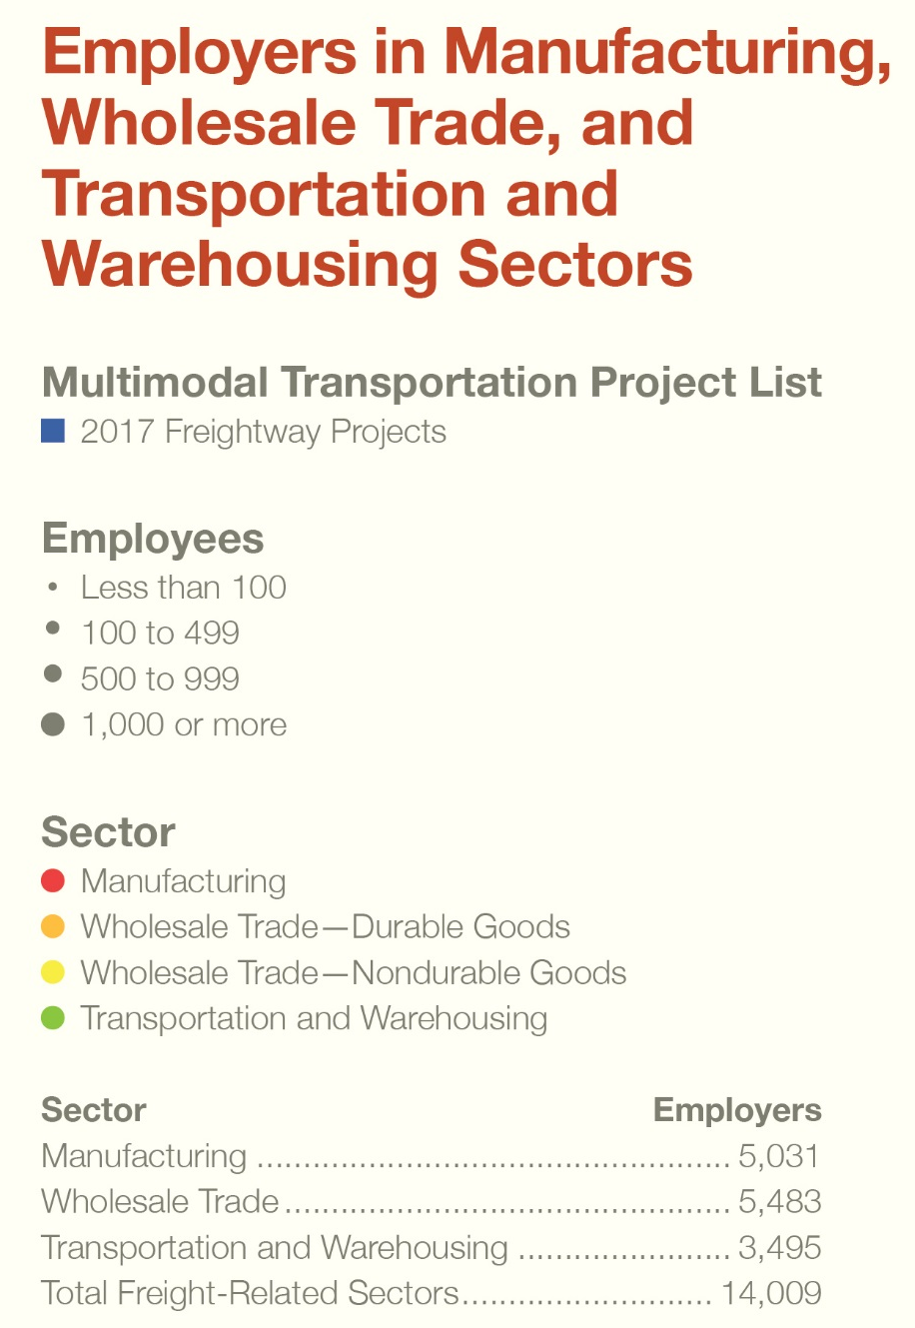
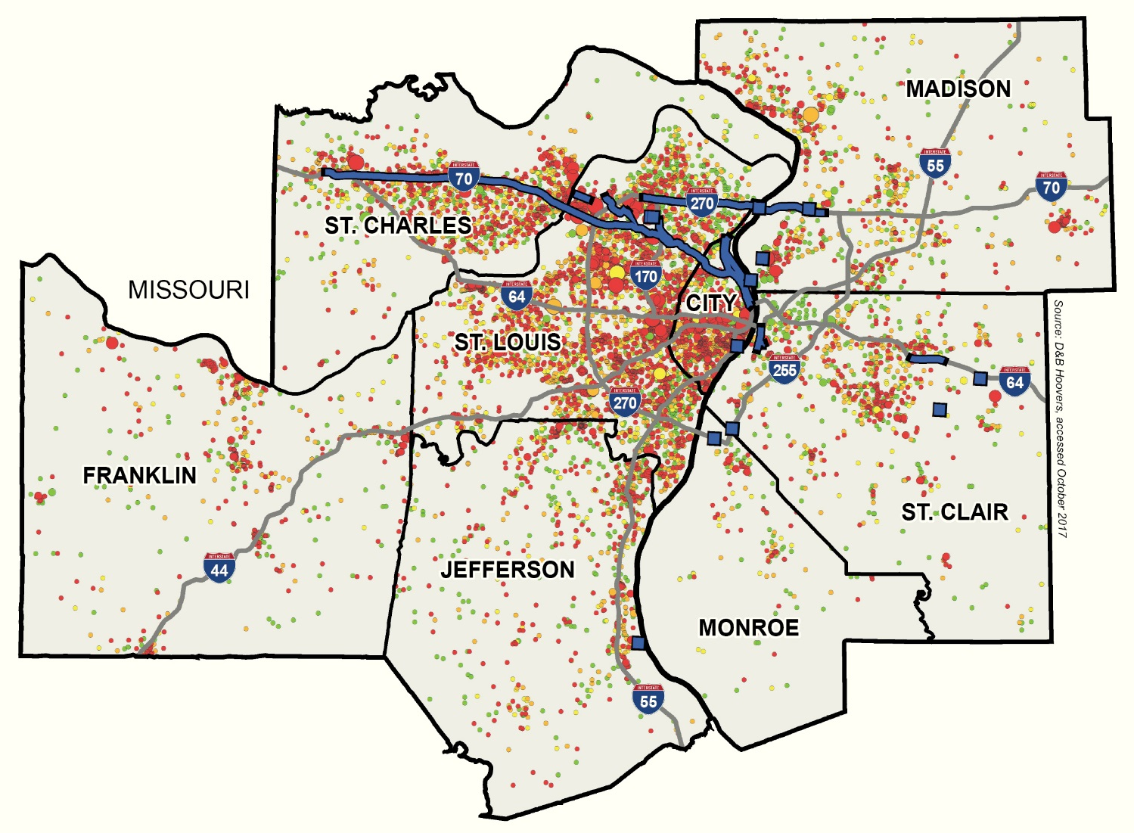
Notes:
MCL

Slide 9
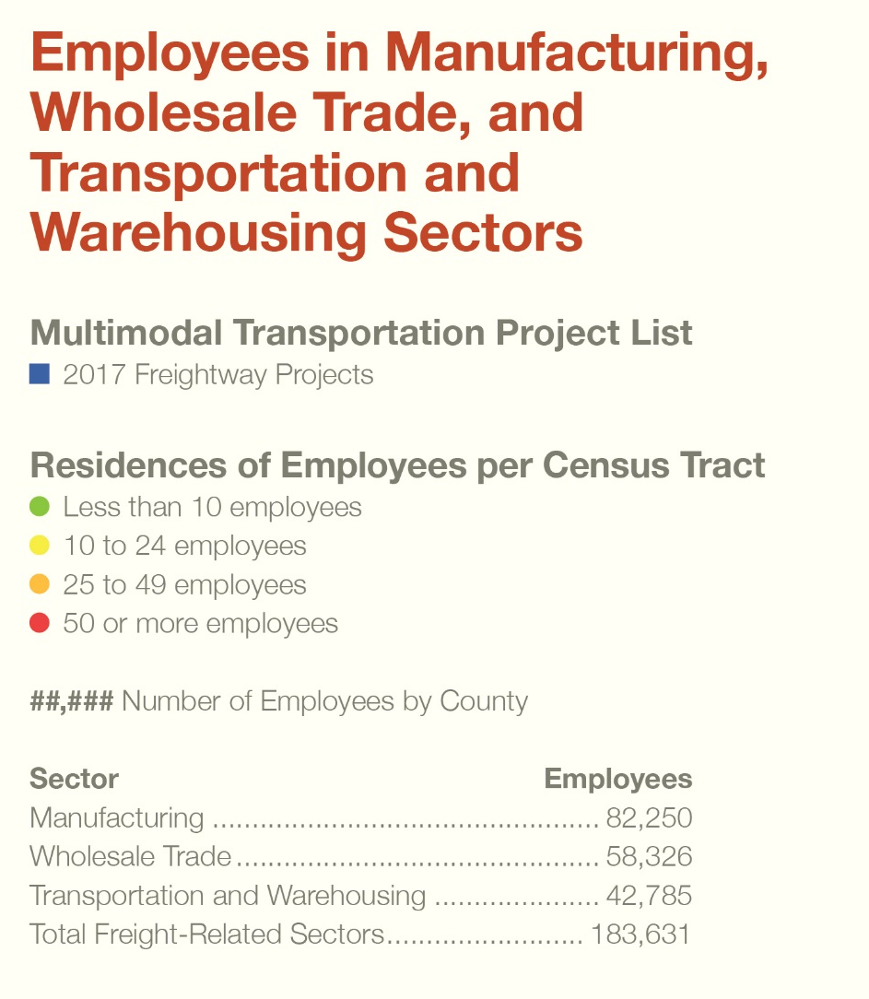
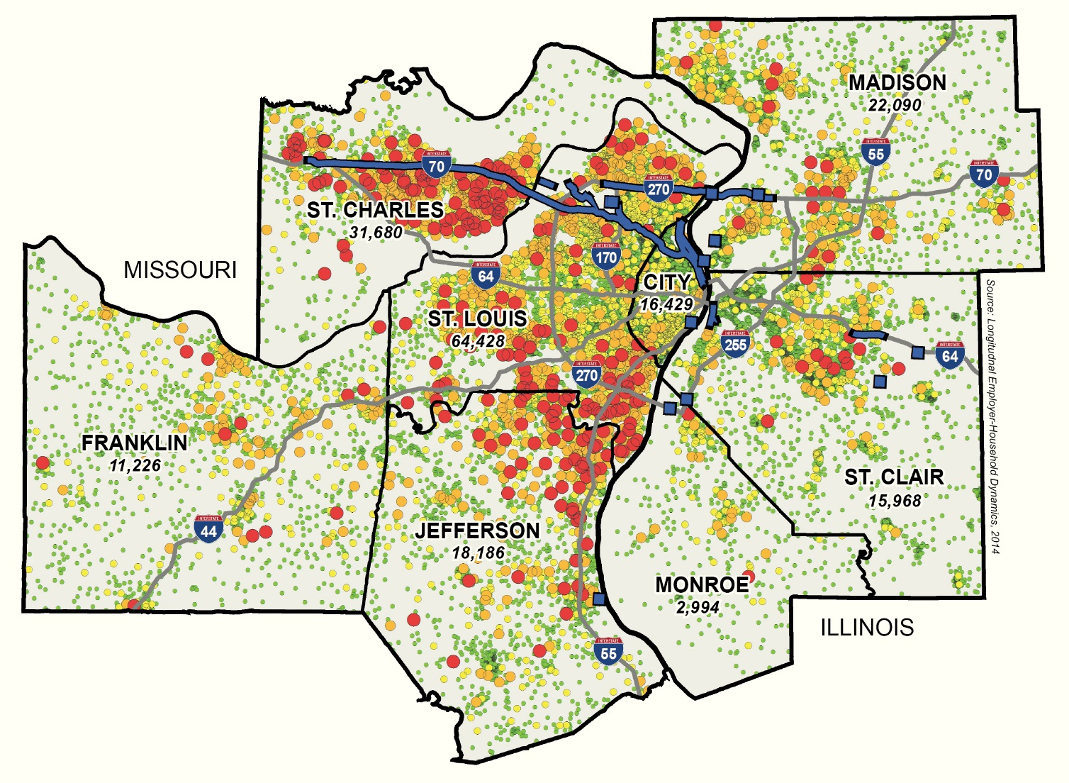
Notes:
MCL

Slide 10
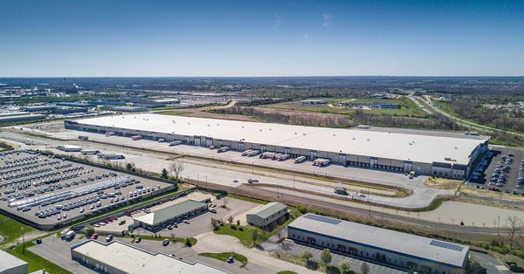
Updates - Supply Chain is the Driver of Industrial Real Estate
Cost of transportation Greater than 50%
Cost of inventory ______21%_____
Cost of labor _____17%______
Cost of real estate ___ 4%_______
  For warehousing at least 500,000sq feet
  Cost of logistics to move product to retail
Notes:
Mary Lamie

Slide 11
Update on MoDOT Infrastructure and the North St. Louis Riverfront Commerce Corridor Partnership

Slide 12
Port Working Group Meeting
    Tom Blair
    St. Louis District Engineer
    MoDOT
    Rob Orr
    Deputy Executive Director
    St. Louis Development Corporation
    Matthew Freix
    Regional Vice President
    DNJ Intermodal Services, LLC
    Brad Reinhardt
    President
    Giltner St. Louis
    Herbert Hall
    Product Supply Warehouse Leader
    Procter & Gamble

Slide 13
MoDOT St. Louis District Freight Update
Tom Blair, P.E.
District Engineer
Notes:
MoDOT

Slide 14
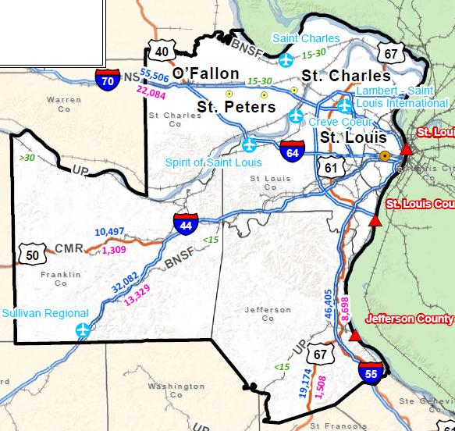
St. Louis District
Notes:
SL District

Slide 15
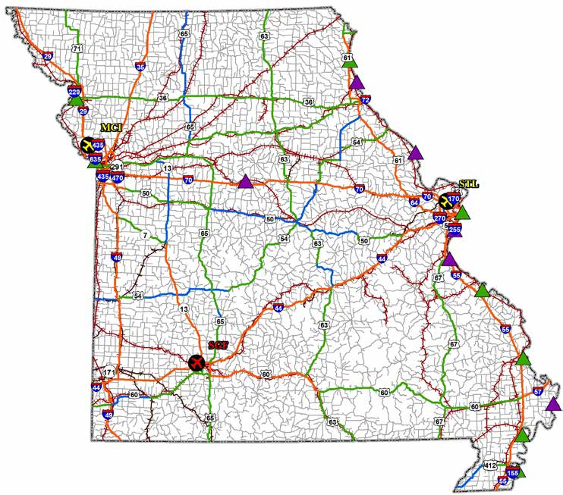
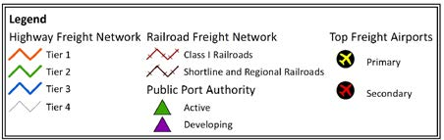
Freight Network

Slide 16
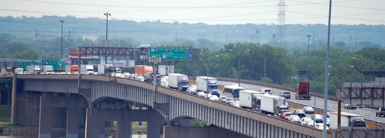
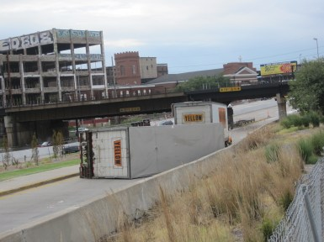
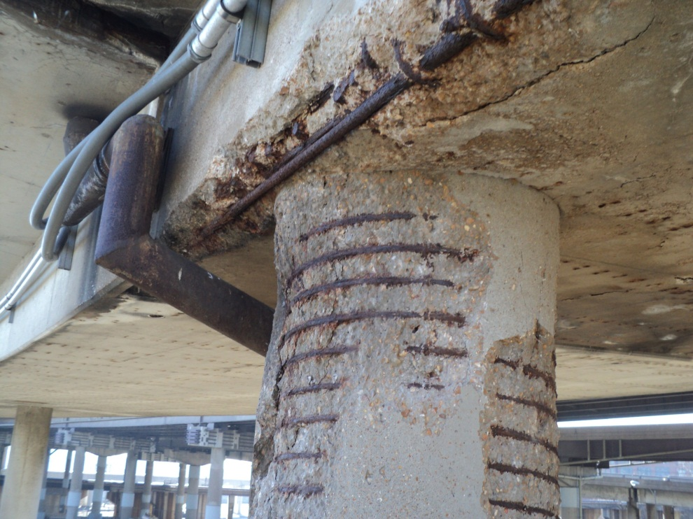
Poplar Street Bridge
Notes:
There are 3 problems with the PSB:
1) Traffic Congestion,
2) Traffic Safety,
3) Bridge Ramp Condition.
These problems have been an issue for a long time and they are the reason MoDOT and IDOT embarked on a study in 1991 to determine how to address the problems.
3 Interstates cross PSB
125,000 vehicles per day
150,000 projected by 2030
40 year old substandard design
Severe congestion due to PSB choke pointThe PSB has an accident rate over 3 times higher than either Missouri or Illinois statewide average. The proposed project is estimated to eliminate more than 165 crashes in the year 2020, including one fatality and 49 injury accidents. These avoided traffic crashes are anticipated to yield more than $4.6 million in accident savings in the design year 2020.
The PSB ramps are narrow, and require vehicles to travel 25 mph to remain safe. Often, tractor trailers and other vehicles roll off the ramps, causing further traffic congestion and backups. The Mississippi River Bridge will help some, but ultimately, improvements need to be made to the Poplar Street bridge to improve traffic flow, and safety.
The 40 year old design is now substandard. Too many decisions points are placed in too close proximity at both approaches to the bridge so that motorist do not have adequate distance to weave or merge and diverge out of the traffic flow.

Slide 17
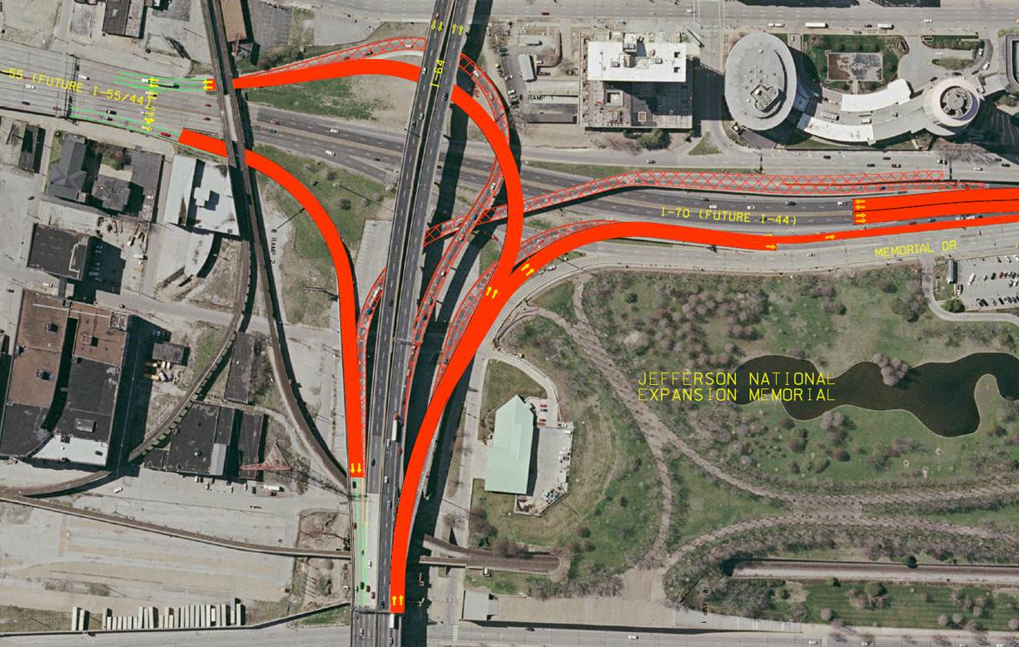
Poplar Street Bridge

Slide 18
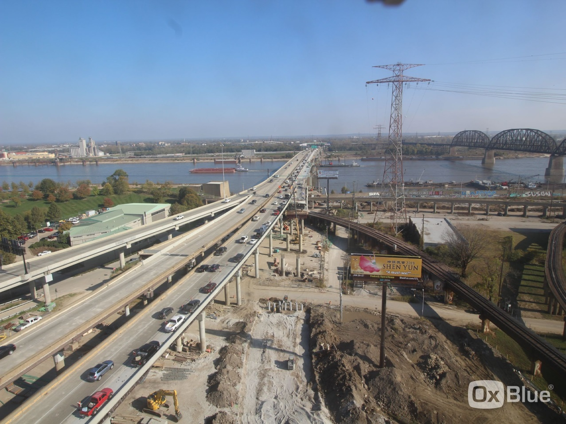
Poplar Street Bridge
What’s Next:
EB bridge to add 5th lane
I-55 – I-64 ramp closed through February
Cost: $80M since 2014

Slide 19
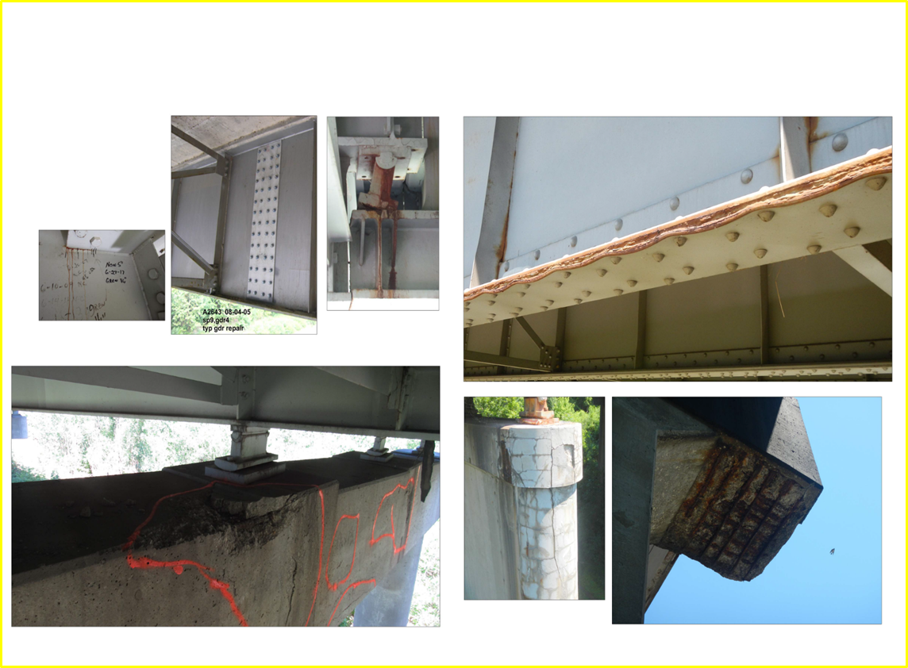
I-44 Improvements
I-44 Bridge Replacement over the Meramec River Fall of 2018 to 2021
  The entrance ramp from I-270 and the entrance ramp from Watson Road (Route 366) to westbound I-44, and the exit ramp from Soccer Park from westbound I-44 will cross the river on a separate bridge from the westbound lanes improving traffic flow.
I-44 Bridge Work between Kingshighway, 39th Street 2018 – Late 2019
  Rehabilitates UPRR, Vandeventer, Tower Grove bridges
  Replaces Kingshighway, Thurman, 39th Street bridges
  One lane closed around the clock in each direction
I-44 over BNSF Railroad 2018 - Spring 2019
  Three eastbound, two westbound lanes open
  Shrewsbury Ramp to EB I-44 ramp closed
  Resurfacing in Spring 2019
Notes:
MoDOT

Slide 20
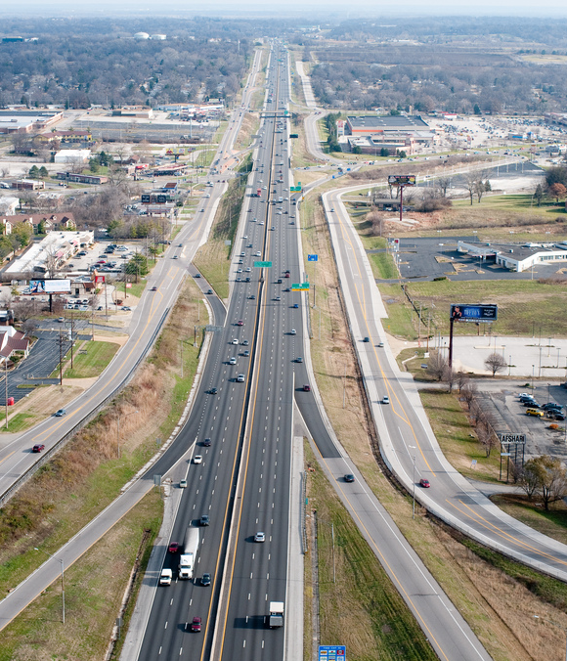
I-270 North Corridor

Slide 21
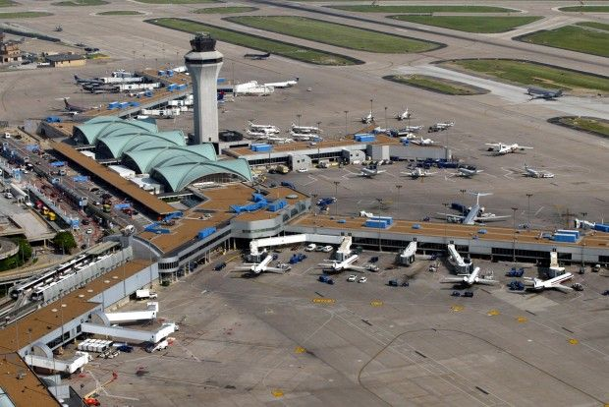
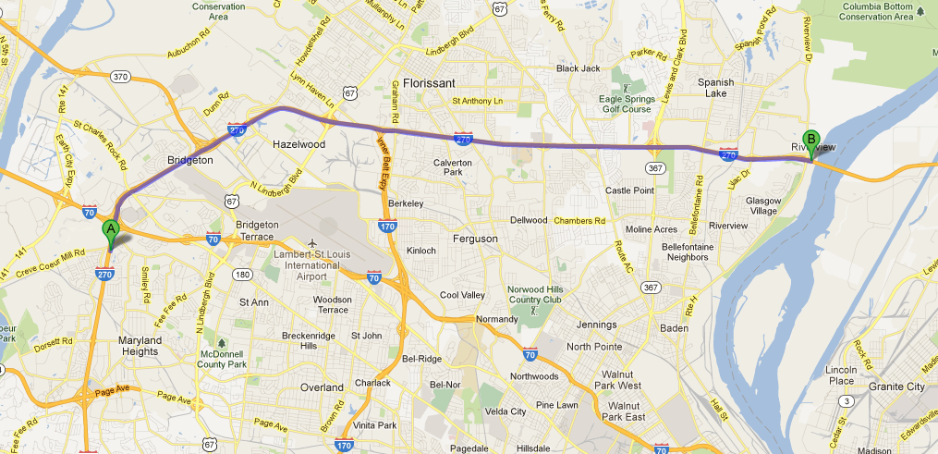




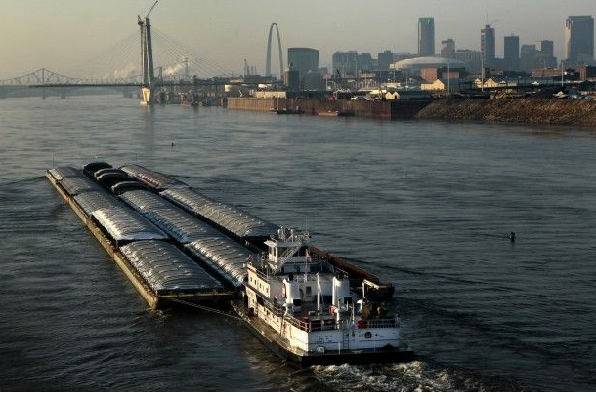




I-270 Connections
  Transportation Hub
  Air Lambert, Boeing
    Rail 6 class 1 Railroads Roads
        Port: Americas Central, STL Metro
      Freight: International, logistics, global supply

Slide 22
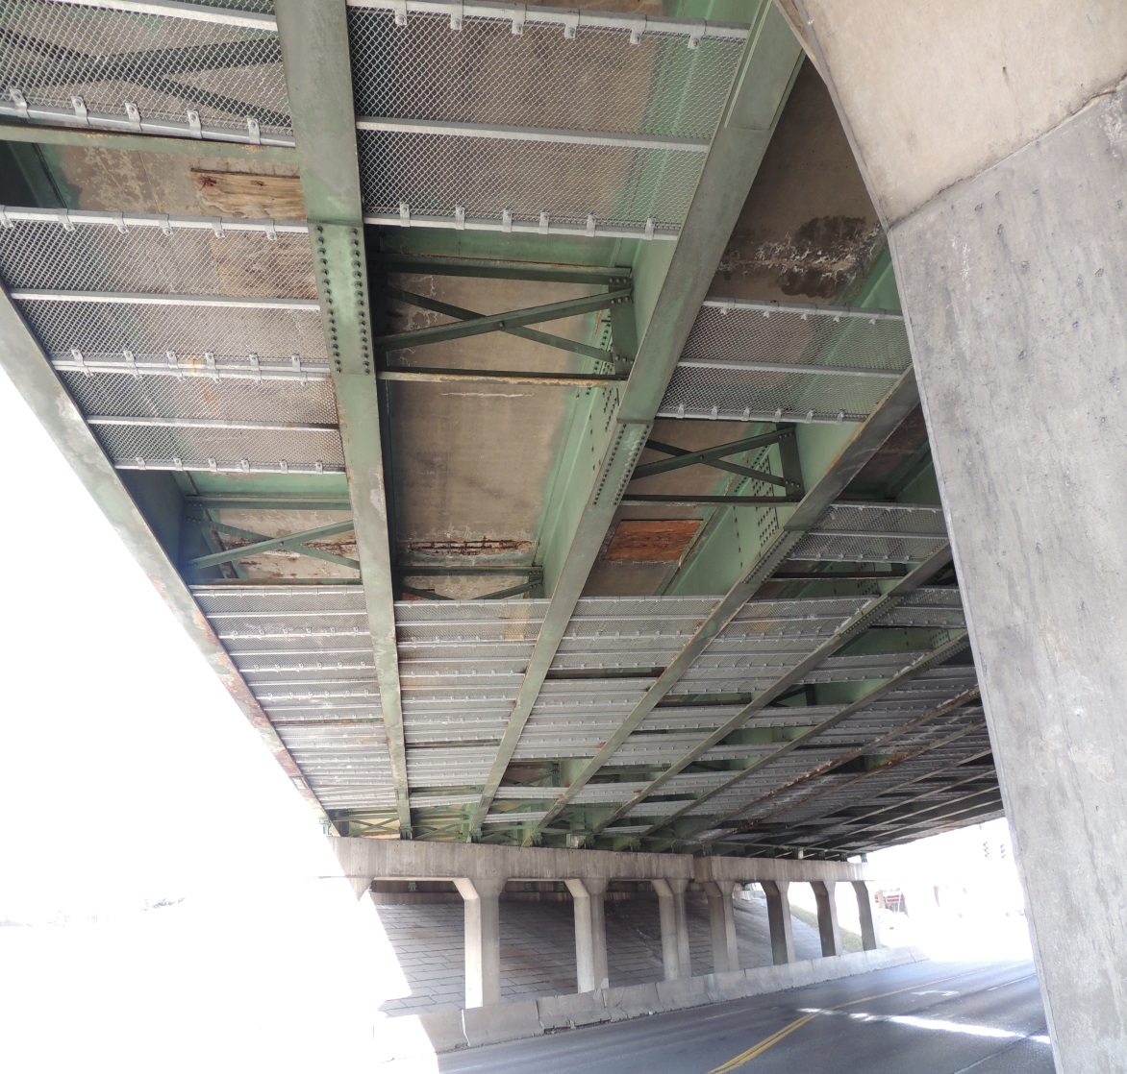
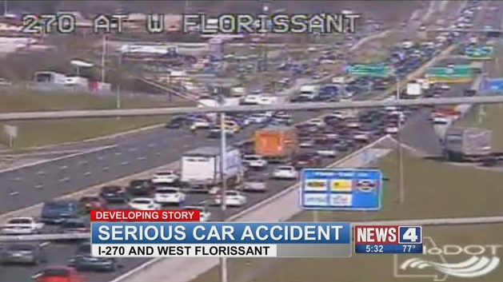
I-270 Issues
Deteriorating Infrastructure/bridges
Safety
Level of Service
$500 - $700 million needs

Slide 23
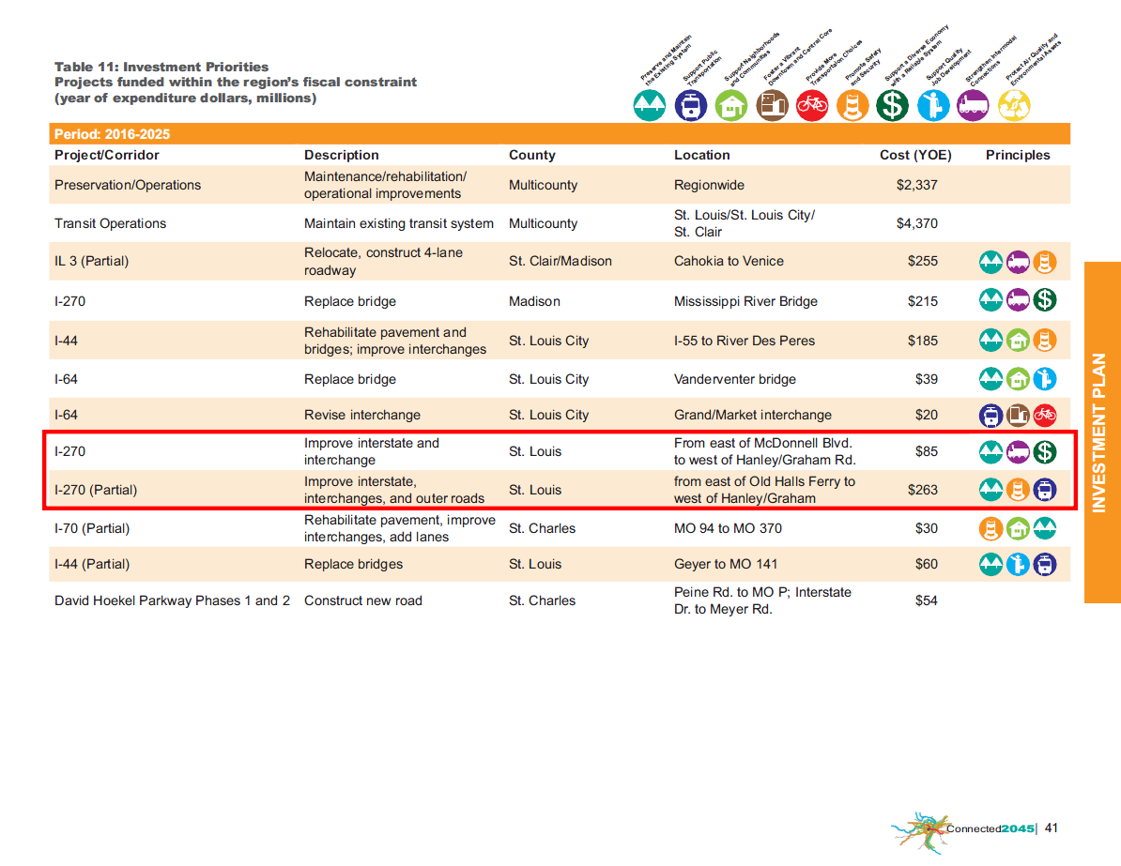
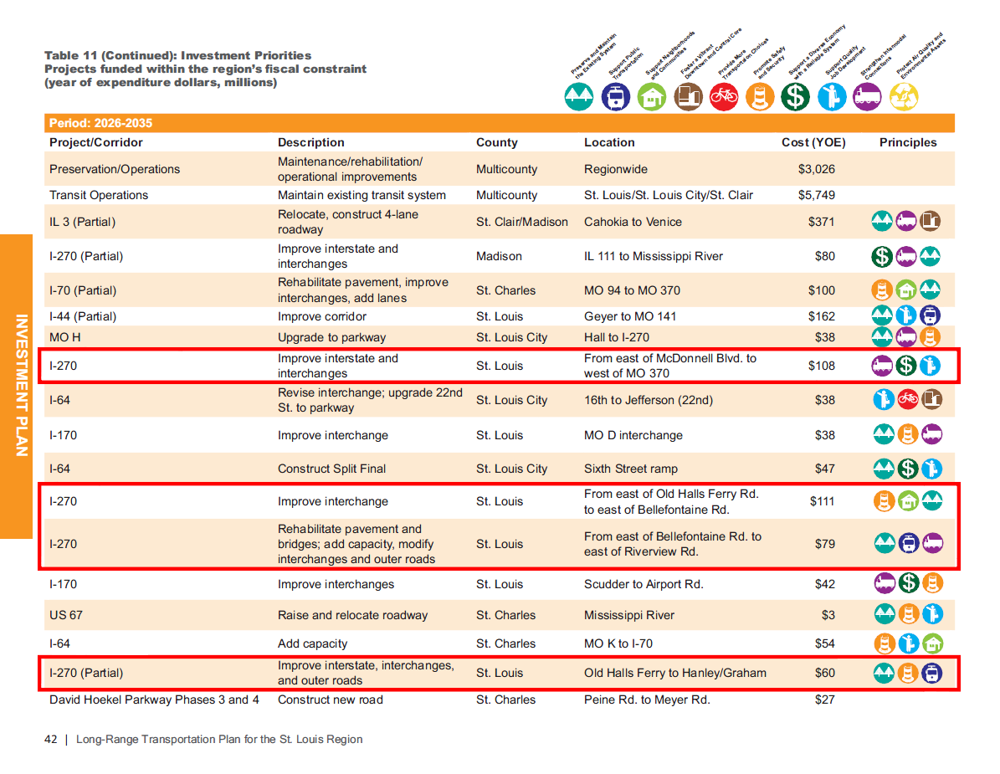
I-270 Opportunities
East-West Gateway Long Range Plan – Connect 2045
  2016 - 2025 $348 Million
  2026 - 2035 $358 Million
  Total $706 Million

Slide 24
I-270 Corridor of Improvements – 16 miles
Lindbergh Boulevard in Missouri to IL Route 111 in Illinois
Mississippi River Chain of Rocks Bridge Replacement (MO-IL)
Corridor Widening from Lilac Avenue to IL Route 111 (MO-IL)
Corridor Improvements from Lilac Avenue to Lindbergh Boulevard (MO)
$1.1B in transportation funding is needed.
Project will be built be over 17 years and administered through 9 or more individual construction contracts.

Slide 25
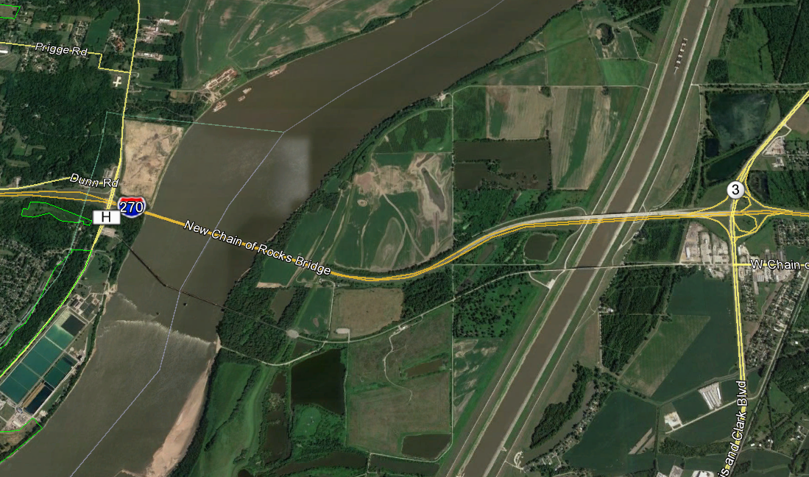
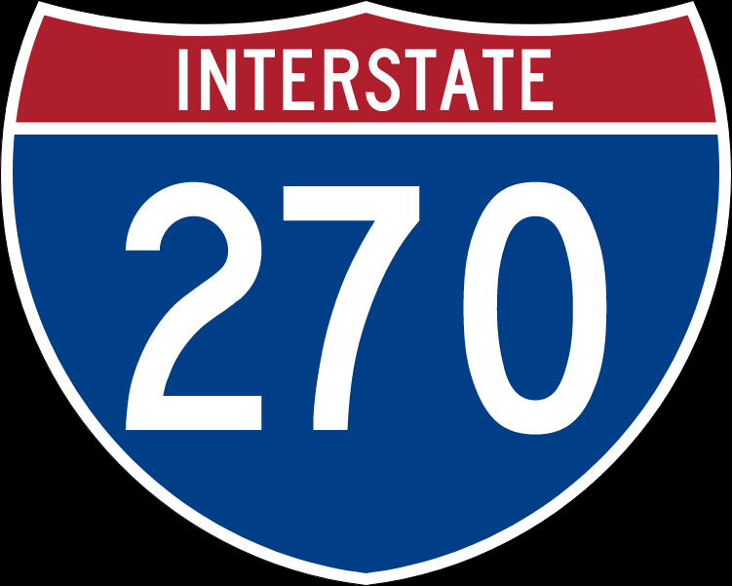
I-270 Corridor of Improvements
Project A: Mississippi River Chain of Rocks Bridge Replacement (MO-IL) IDOT Project
Replace existing 4-lane bridge with a bridge that can accommodate 6 lanes
Bridge is nearing the end of its life expectancy
High impact to travel time delays for maintenance lane closures
At 4 lanes wide, existing bridge is not equipped to handle the large
freight flow increases forecasted by USDOT
Traffic has increased from 19,800 vehicles per day to 51,500
MISSOURI
MISSISSIPPI RIVER
ILLINOIS
Construction duration: 2 – 3 construction seasons
Estimated cost: $225M for all activities construction, PE, UT, LA, etc (unfunded)
If funded, construction could start as early as 2020

Slide 26
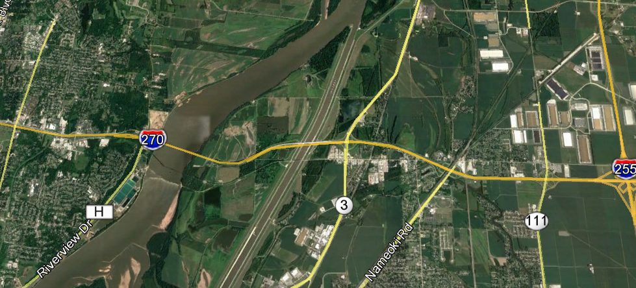
I-270 Corridor of Improvements
Project B: Corridor Widening from Lilac Avenue to IL Route 111 (MO-IL)
7.6 miles; MoDOT and IDOT Projects
Widen from 4 lanes to 6 lanes and improve interchanges
Only segment of I-270/255 loop not at least 6 lanes wide
Supports one of the region’s fastest growing industrial real estate developments – Gateway Commerce and Lakeview Commerce Park
MISSOURI
LILAC AVE.
MISSISSIPPI RIVER
111
ILLINOIS
Estimated construction cost: $350-$400M (unfunded)
If funded, construction could start as early as 2023
Multiple contracts
Construction duration: 5 or more construction seasons

Slide 27
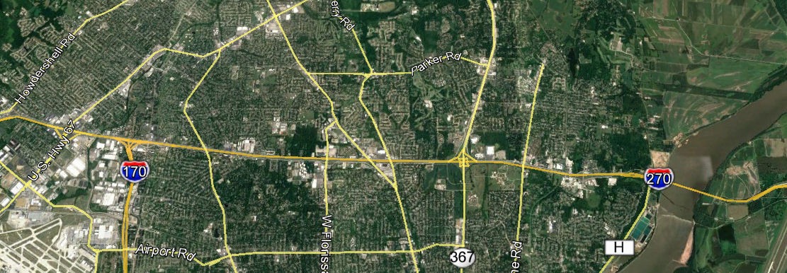
I-270 Corridor of Improvements
Project C: Corridor Improvements from Lilac Avenue to Lindbergh Boulevard (MO)
8.6 miles; MoDOT and IDOT Projects
Safety, congestion and capacity improvements
Constant disruption to traffic with significant
travel time delays negatively impacting the
regions 14,000 manufacturing and
logistics companies
MISSOURI
LINDBERGH BLVD.
LILAC AVE.
MISSISSIPPI RIVER
ILLINOIS
$157M is programmed for a potential design build project
Estimated Construction Cost - $ 500 - $700M (unfunded)
Construction duration - 17 years
6 separate contracts

Slide 28
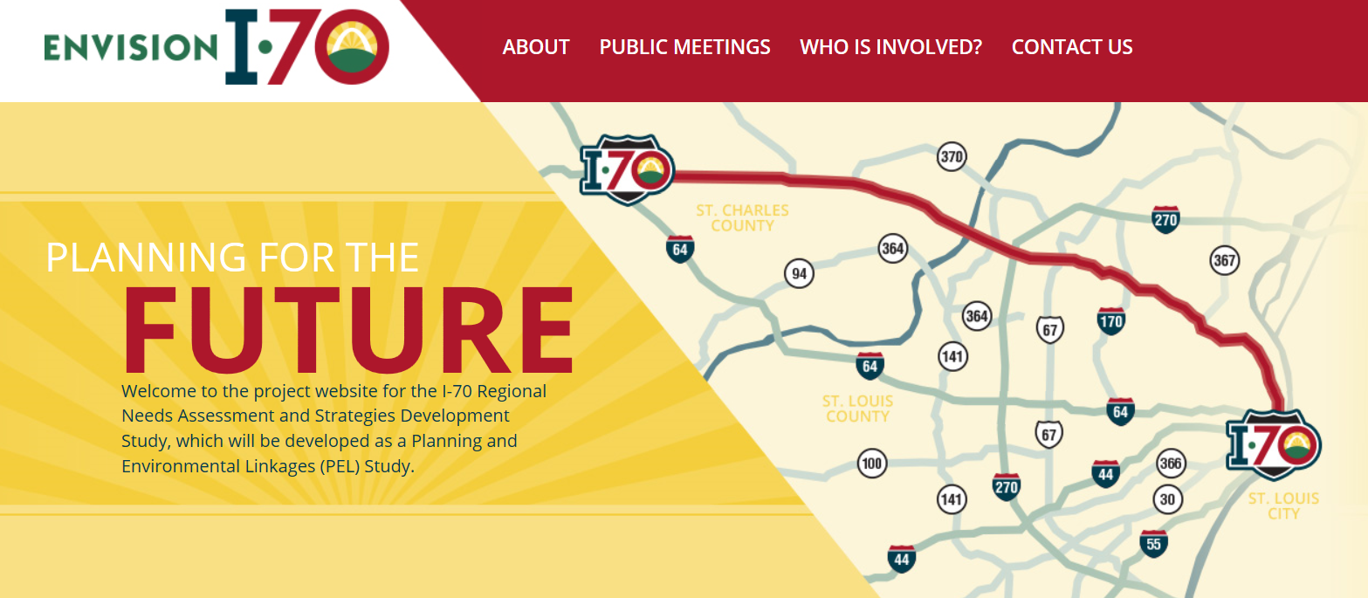



I-70 Regional Needs Assessment and Strategies Development Study
A Planning and Environmental Linkages (PEL) Study

Slide 29
Purpose & Need
Purpose Statement
The purpose of this study is to investigate and identify the transportation problems in the I-70 corridor and to recommend transportation improvements, solutions, and strategies that would:
Increase safety on the corridor
Manage existing and future traffic congestion
Improve efficiency and reliability of freight movement, and
Address identified deficiencies in pavement conditions, substandard bridges, and other physical assets
A Planning and Environmental Linkages (PEL) Study

Slide 30
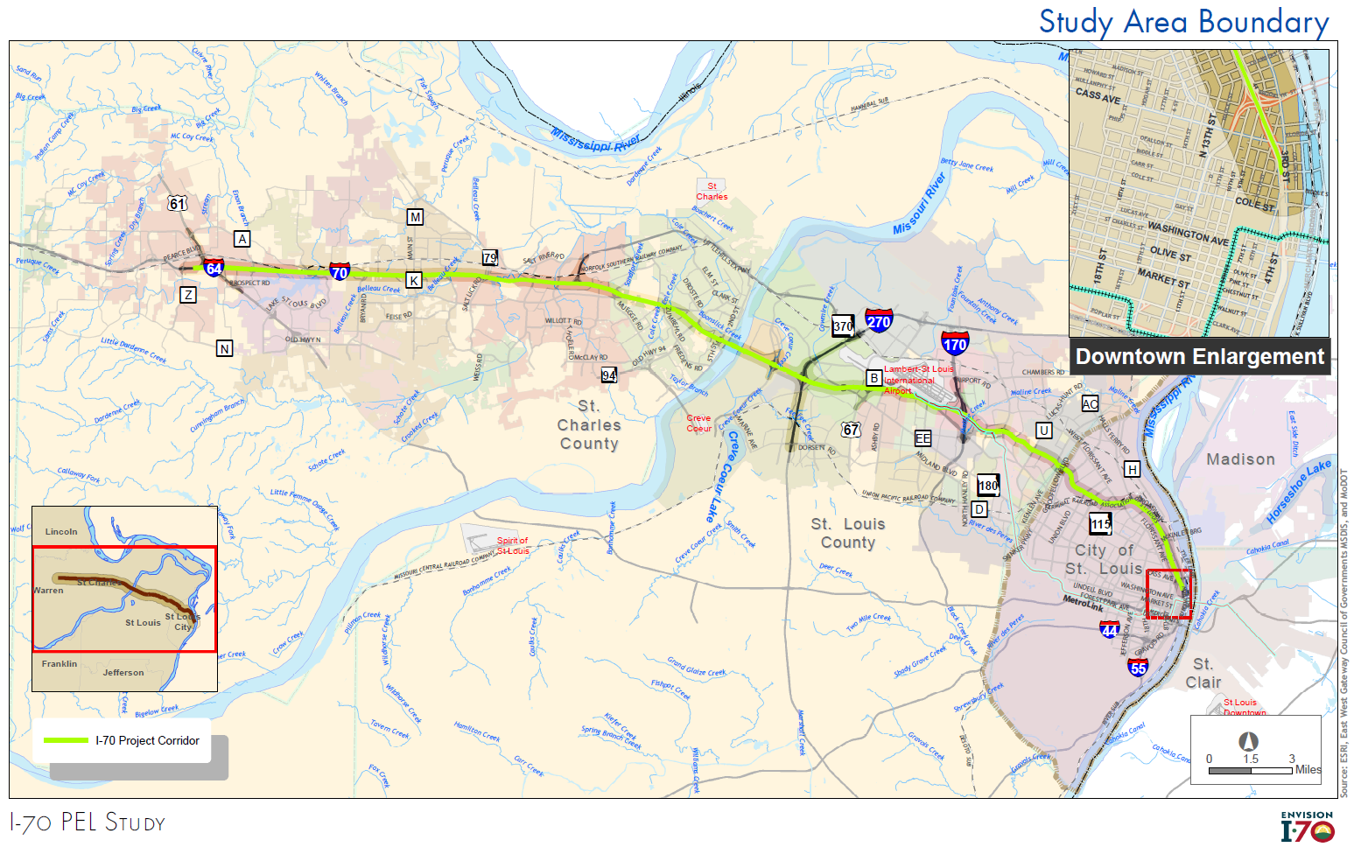
I-70 PEL STUDY
A Planning and Environmental Linkages (PEL) Study
Notes:
I-64/US 61, St. Charles County to End of the Reversible Lanes, St. Louis City
Total Length 40 miles
St. Charles County – 20 miles
St. Louis County – 13 miles
St. Louis City – 7 miles

Slide 31
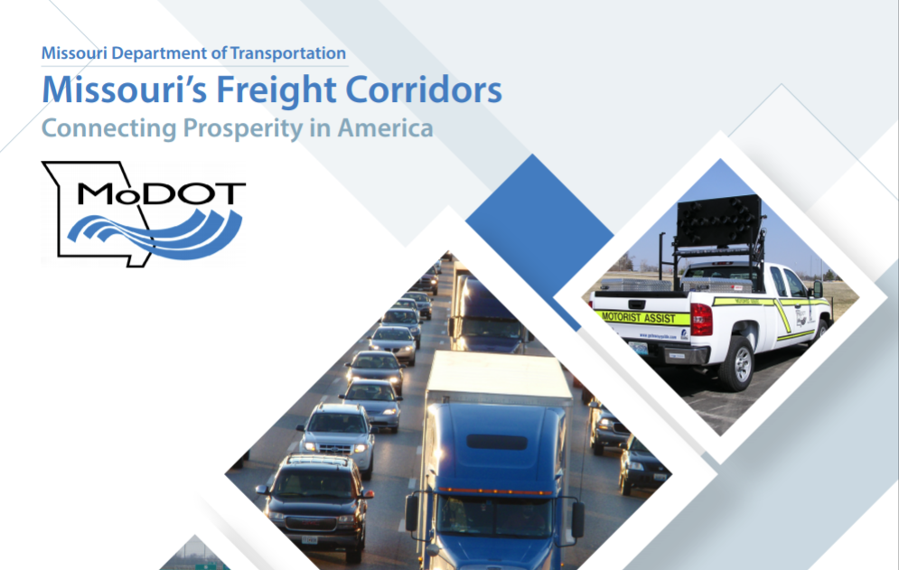
2018 Update
Missouri’s Freight Corridors INFRA Grant Request
Nearly $1B Initiative:
  Seeking $194M INFRA Grant to supplement more than $775M state funds
  USDOT Primary Highway Freight Network
  Corridors: I-270, I-70, and I-44
  Freightway Priority Project Advancement
    I-270 North Improvements
    I-70 Reconstruction and 6-Lane Expansion
Notes:
Barb Frost/Tom Blair

Slide 32
North Riverfront Commerce Corridor Update
Rob Orr
Deputy Executive Director
St. Louis Development Corporation
Notes:
MoDOT

Slide 33

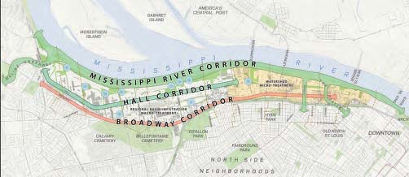
North Riverfront Commerce Corridor
Partnership Between St. Louis Development Corporation (SLDC), MoDOT,
Metropolitan St. Louis Sewer District (MSD) and the City of St. Louis
North Riverfront Commerce Corridor Land Use Plan
EDA-funded study completed in 2012
3,000 acre area study area bounded by Moline Creek (north), Mississippi River (east), Cass Avenue (south), I-70/Broadway (west)
www.stlouis-mo.gov/government/departments/ planning/documents/north-riverfront-commerce-corridor-land-use-plan11.cfm

Slide 34
North Riverfront Commerce Corridor
Priority Infrastructure Projects
I-70 North Broadway Exit Ramp Relocation
Hall Street Improvements from
  East Grand Avenue to Adelaide Avenue
  Adelaide Avenue to Riverview Drive
Riverview Drive from Hall Street to I-270
Branch Street Improvements

Slide 35
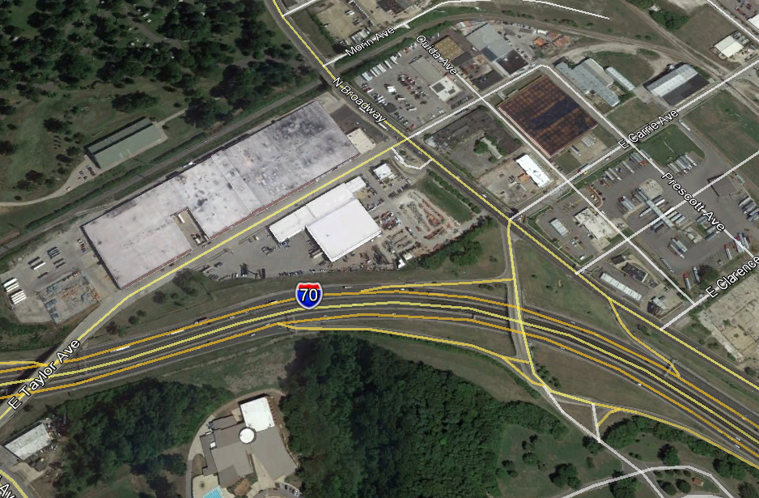
North Riverfront Commerce Corridor
I-70 Westbound off-ramp to North Broadway- Relocation to Carrie Avenue
MoDOT project
Relocate the westbound exit ramp at North Broadway to Carrie Avenue
Ramp will be reconfigured and lengthened to allow westbound vehicles on I-70 to exit and turn south on North Broadway
Construction is underway and will be completed spring 2018
CARRIE AVE.
NORTH BROADWAY
X
Notes:
MoDOT

Slide 36
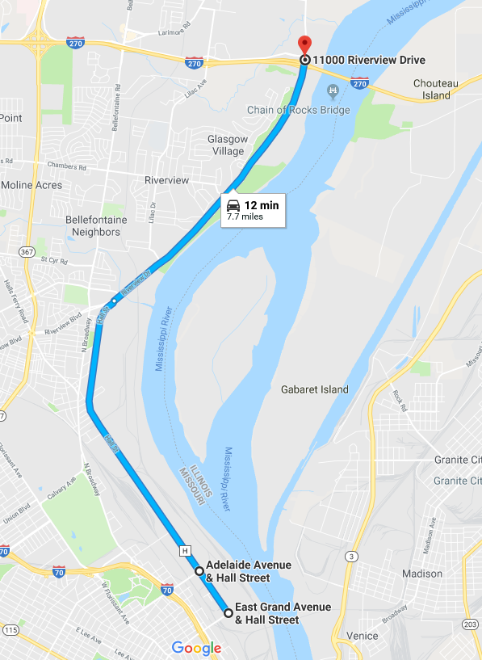
North Riverfront Commerce Corridor
I-270
North Hall Street & Riverview Drive
Benefits:
Pavement drainage (reduce ponding)
Stormwater improvements (green infrastructure where possible)
Resurfacing and median improvements
Segments:
East Grand Avenue to Adelaide Avenue - 0.6 miles
Adelaide Avenue to Riverview Drive – 3.6 miles
Riverview Drive to I-270 – 3.4 miles
●
●
●

Slide 37
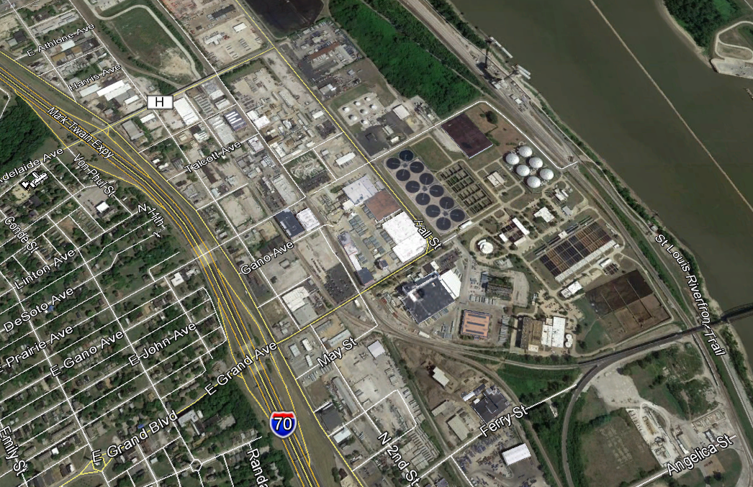
North Riverfront Commerce Corridor
Hall Street Improvements from East Grand Avenue to Adelaide Avenue
Funded $1.3M MSD; $3.0M STP-S
Design 2018; Construction 2019
Added benefits:
  Lane diet to control speed (restriction of lanes/widths)
  Bike path base from E. Grand to Prairie for future connection to riverfront trail
ADELAIDE AVE.
HALL STREET
MISSISSIPPI RIVER
E GRAND AVE.
Notes:
MoDOT/ CITY OR BOTH

Slide 38
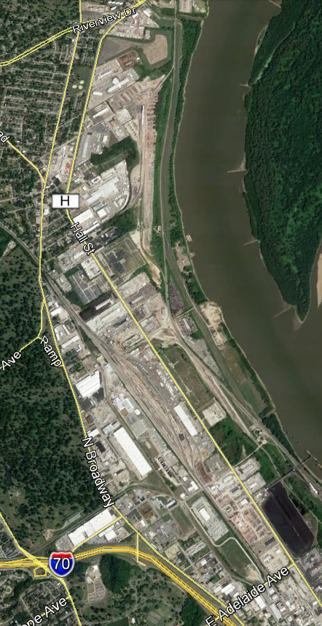
North Riverfront Commerce Corridor
RIVERVIEW DR.
Hall Street Improvements from Adelaide Avenue to Riverview Drive
MSD has funds committed for storm water improvements
MoDOT plans to resurface the roadway
MSD will work with MODOT to coordinate design/construction schedules
Targeting 2020-2021 construction; 24 month schedule
HALL STREET
MISSISSIPPI RIVER
MISSISSIPPI RIVER
MISSISSIPPI RIVER
ADELAIDE AVE.
Notes:
MoDOT/ CITY OR BOTH
we will be considering a road diet and possible raised medians on these segments to improve safety and reduce the high rates of speed and eliminating the two way left turn lane.

Slide 39
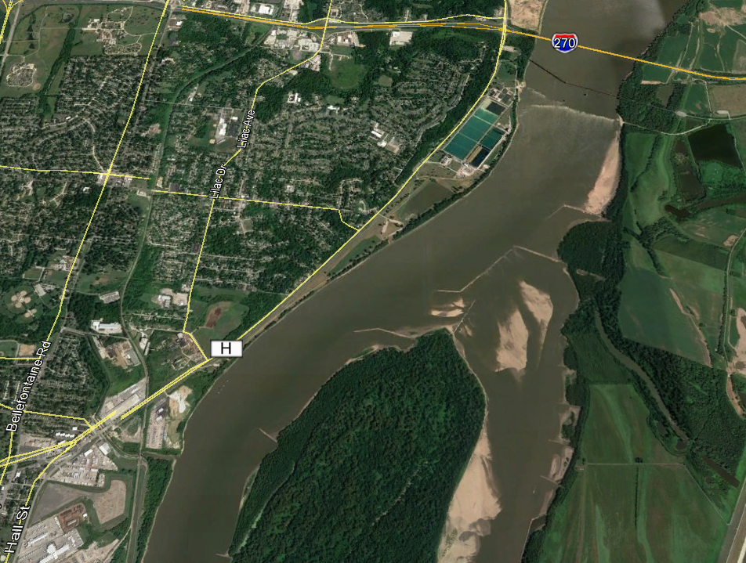
North Riverfront Commerce Corridor
Riverview Drive from Hall Street to I-270
STIP has estimated $5.3M
Construction projected for 2020
MSD may seek future funding for stormwater improvements (requires voter approval)
Intersection will be realigned and signal replacement at Hall Street and Riverview Drive
Construction projected for 2019
MISSISSIPPI RIVER
HALL STREET
Notes:
MoDOT/ CITY OR BOTH
we will be considering a road diet and possible raised medians on these segments to improve safety and reduce the high rates of speed and eliminating the two way left turn lane.

Slide 40
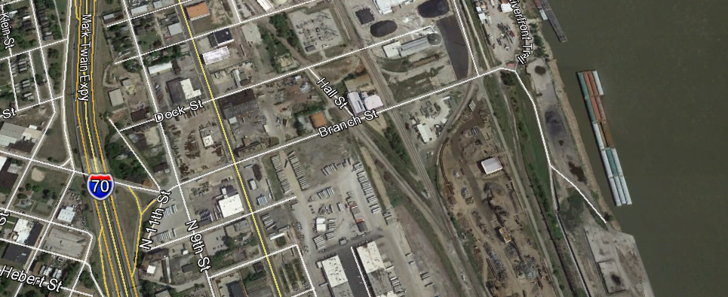
North Riverfront Commerce Corridor
Branch Street Improvements - Levee Road to 14th Street in North St. Louis
Provide for continuous access to the Municipal River Terminal even when the Market Street flood wall gate is closed
At-grade crossing Improvements
Not currently funded
MISSISSIPPI RIVER
BRANCH STREET
Notes:
MoDOT/ CITY OR BOTH

Slide 41
North Riverfront Commerce Corridor
Website: https://www.stlouis-mo.gov/government/departments/sldc/NRCC.cfm

Slide 42
Port Working Group Meeting
    Tom Blair
    St. Louis District Engineer
    MoDOT
    Rob Orr
    Deputy Executive Director
    St. Louis Development Corporation
    Matthew Freix
    Regional Vice President
    DNJ Intermodal Services, LLC
    Brad Reinhardt
    President
    Giltner St. Louis
    Herbert Hall
    Product Supply Warehouse Leader
    Procter & Gamble

