Slide 1
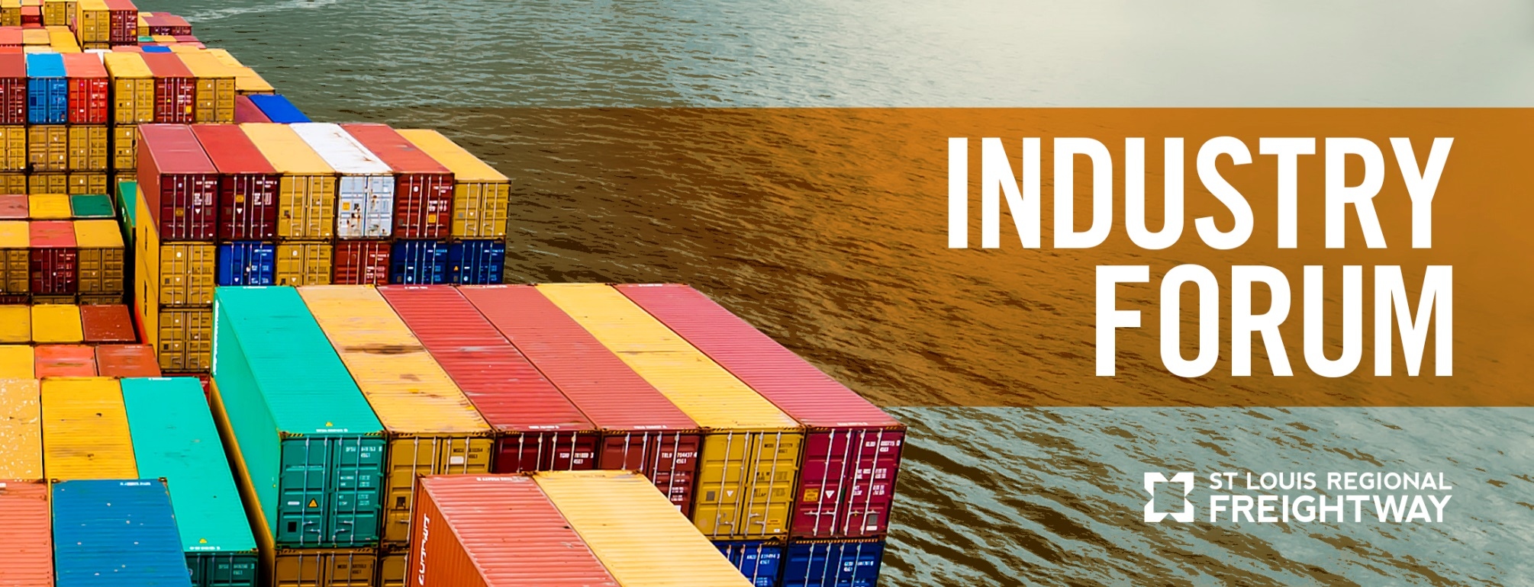


Slide 2


Slide 3
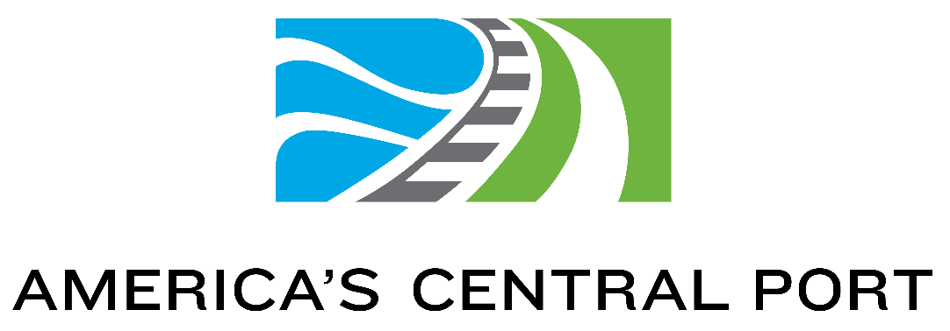

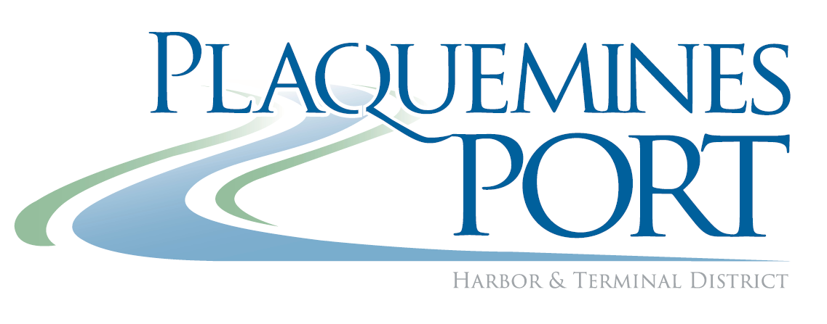

Presenting Sponsors

Slide 4


Supporting Sponsors

Slide 5
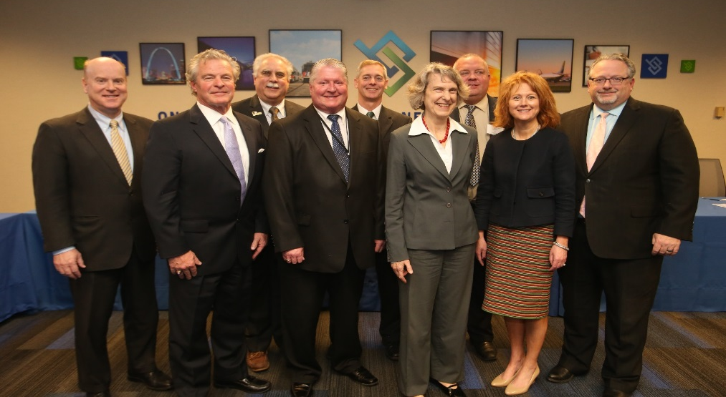
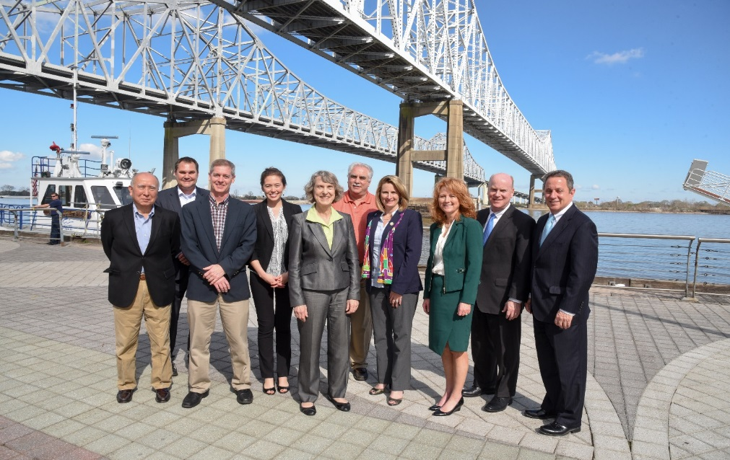
Strategic Partnerships
Partnering with Midwest Ports :
  Port of Plaquemines
  Port of New Orleans
  Port of Cleveland
  Port of Chicago
  Port of Paducah
  Port of Kansas City
  Port of Memphis
  Port of Little Rock
  U.S. Dept. of Transportation
  Mega-Regions
  Models of Cooperation

Slide 6
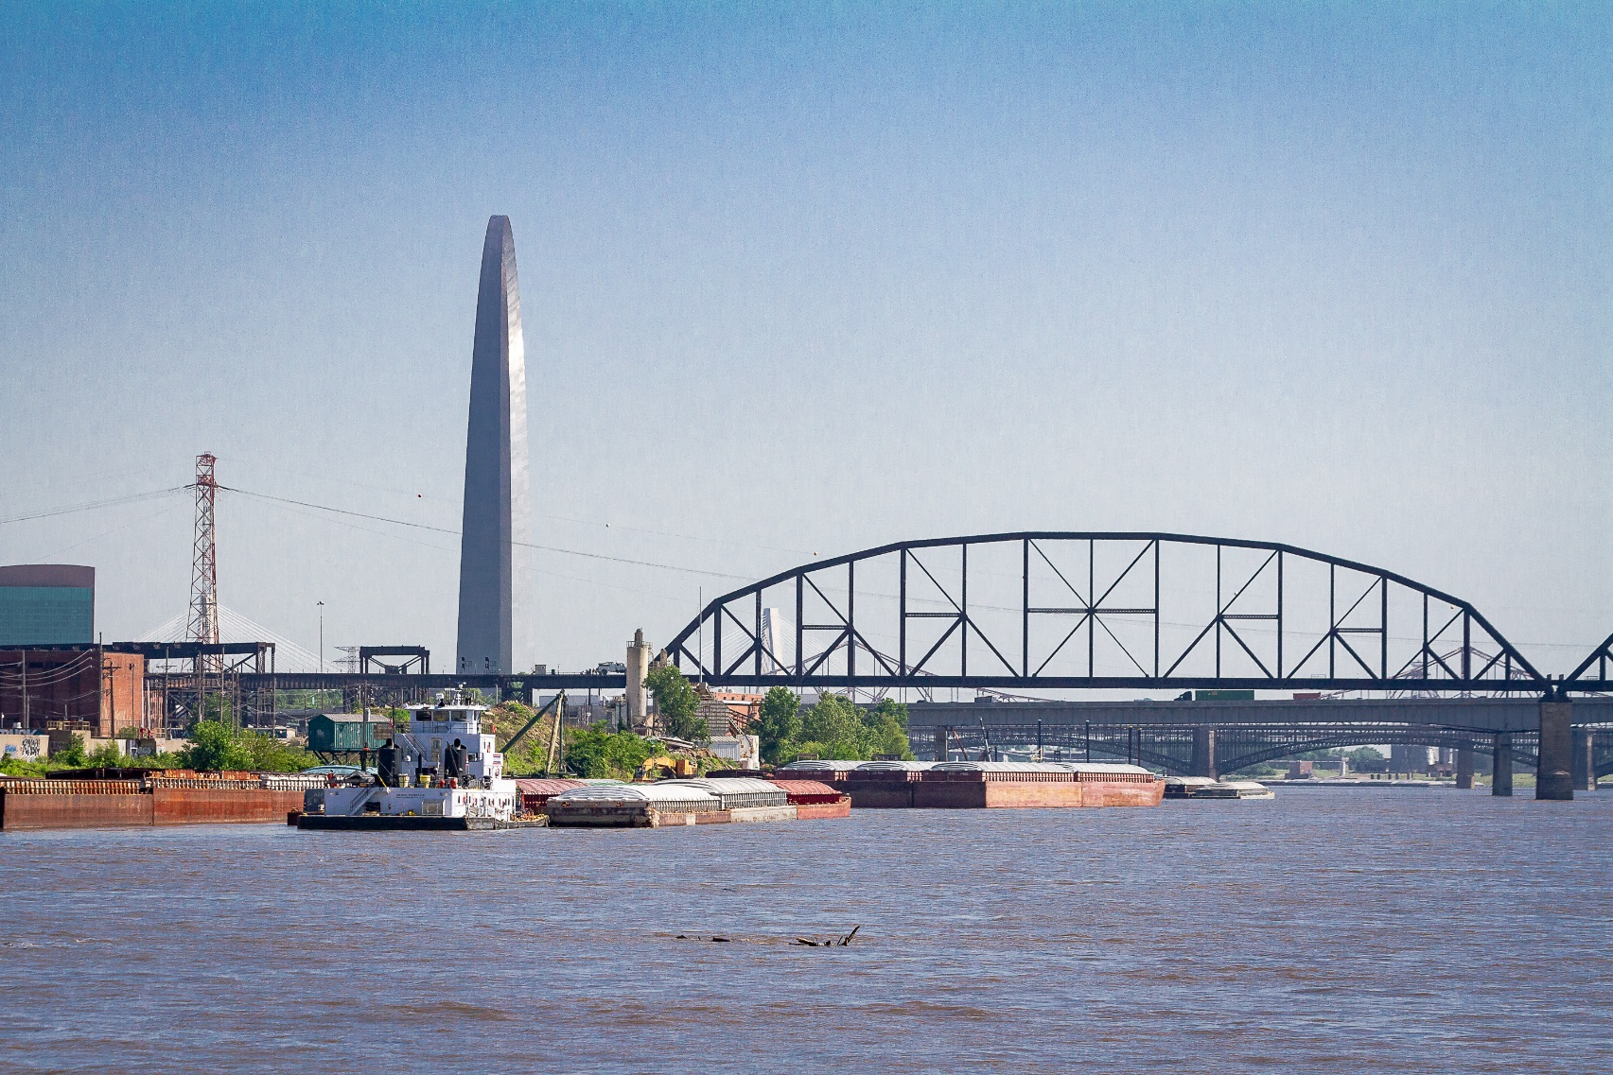
The Challenge Ahead
Freight volumes will increase 45% over the next 30 years
Strong container volume growth
U.S. losing cost advantage in the soybean export market with South America
Notes:
Lamie

Slide 7
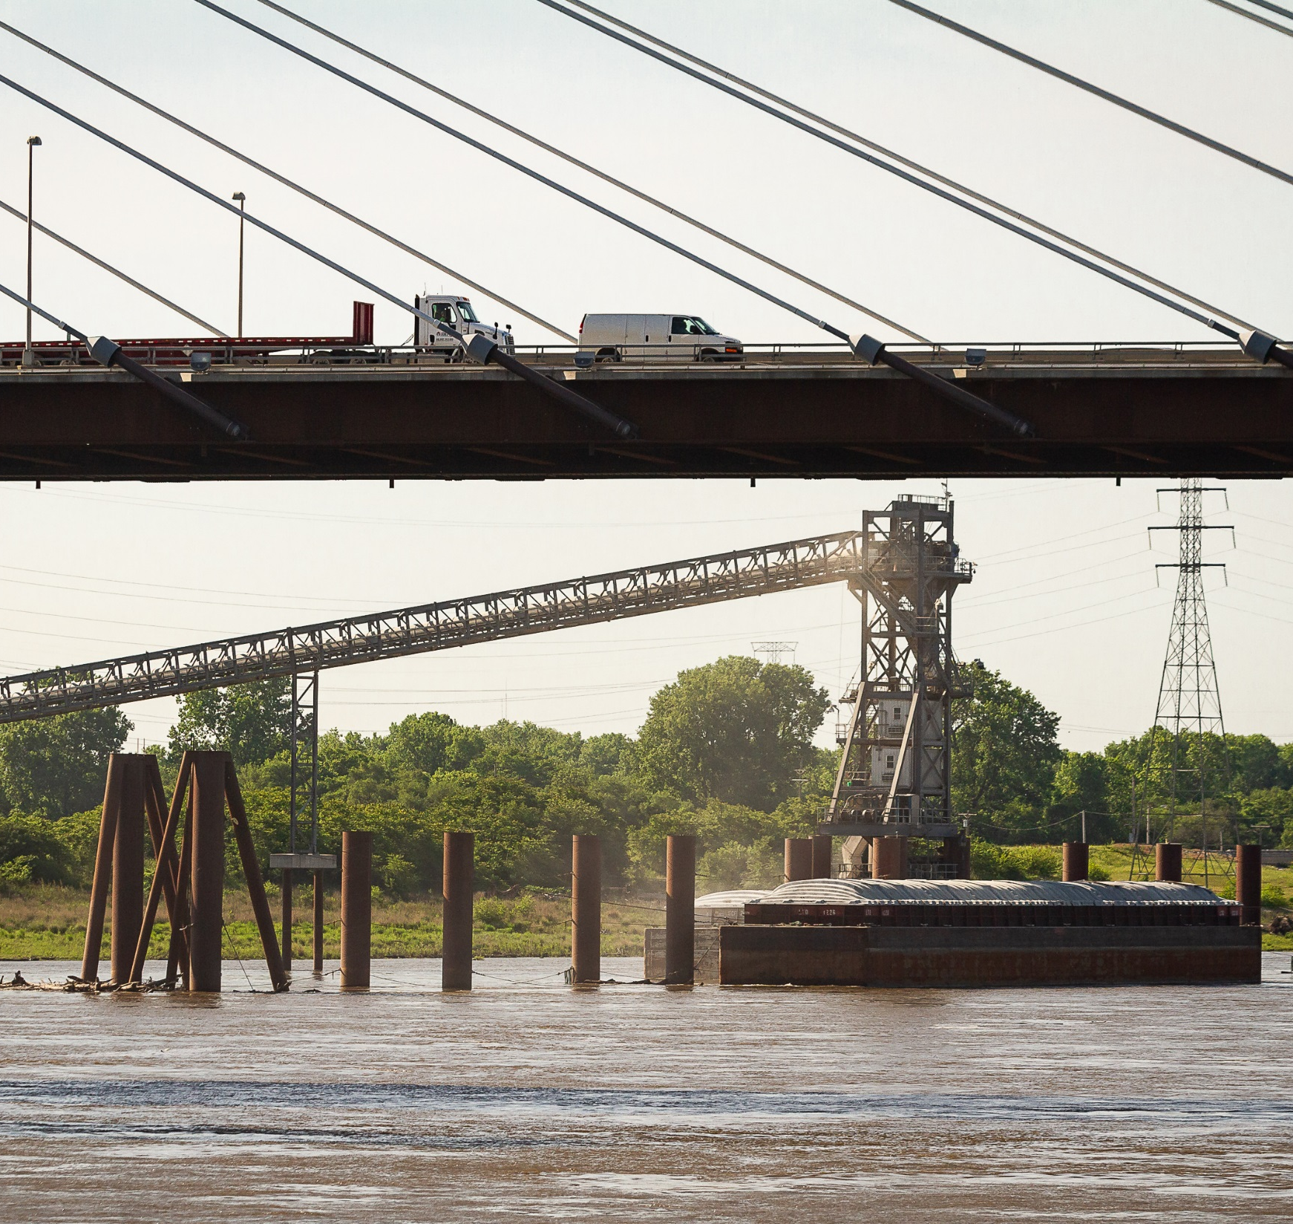
Innovative Path Forward
Infrastructure investment
Public-private partnerships to maximize funding opportunities
New option to transport freight
Offering reliability, efficiency, cargo flexibility, sustainability, and competitive price advantage

Slide 8
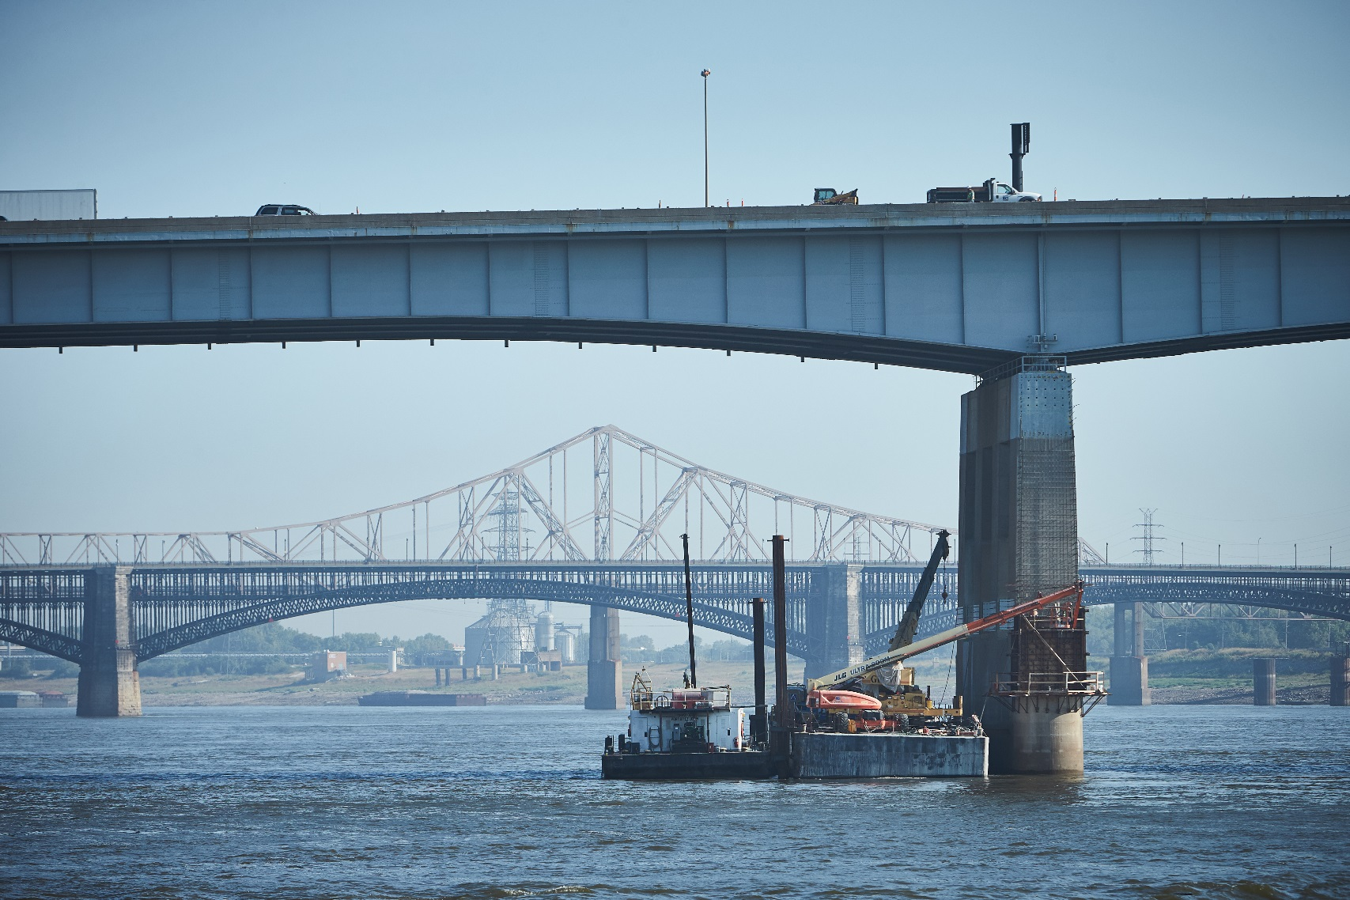
Keys to Success
Integrate all modes of transportation
Expand and establish freight consolidation/de-consolidation center to generate freight volumes
Building Partnerships
Kansas City, Memphis, Little Rock and Mississippi River Basin to jointly create the volume to support a new service
Notes:
Lamie

Slide 9
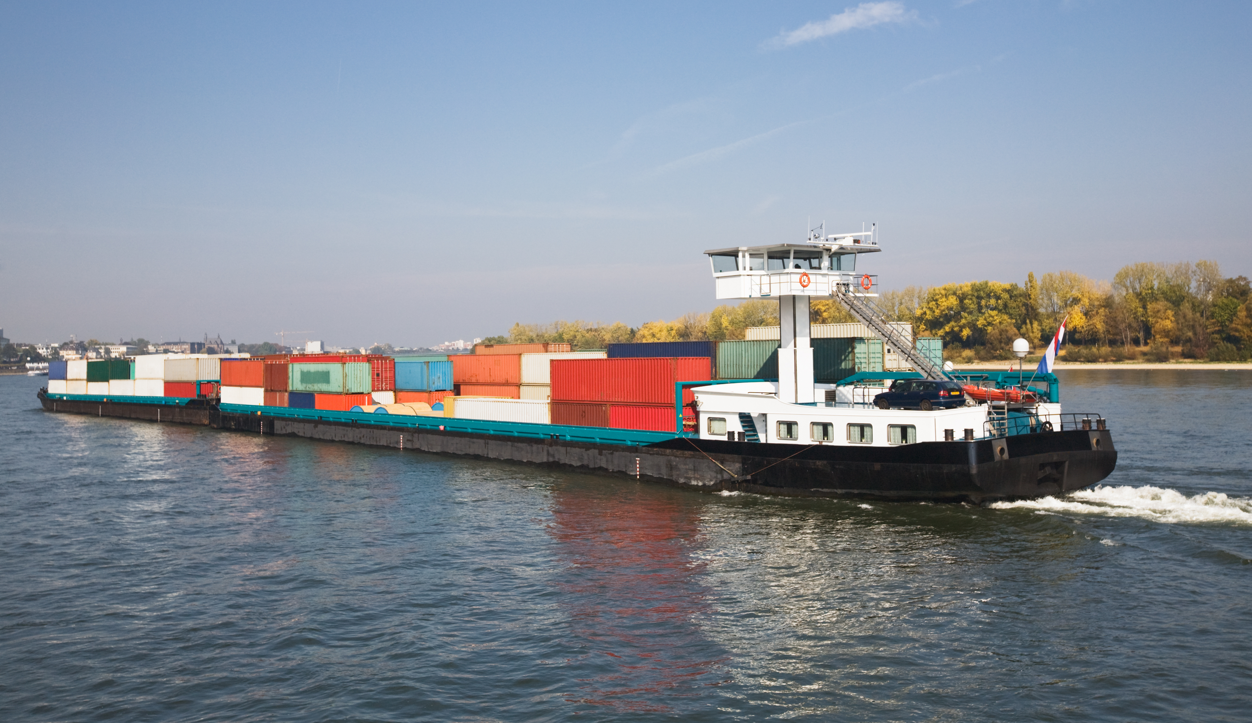
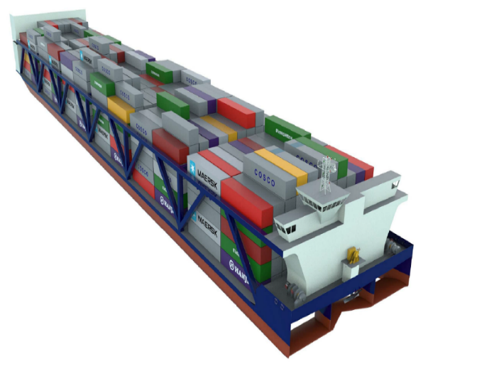
It’s a Process
Container on Barge
Container on Vessel

Slide 10

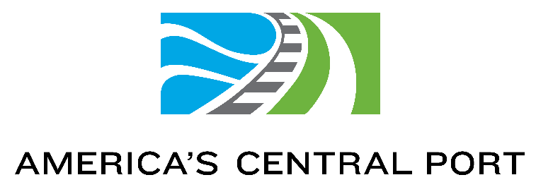

Dennis Wilmsmeyer
Executive Director
America’s Central Port

Slide 11
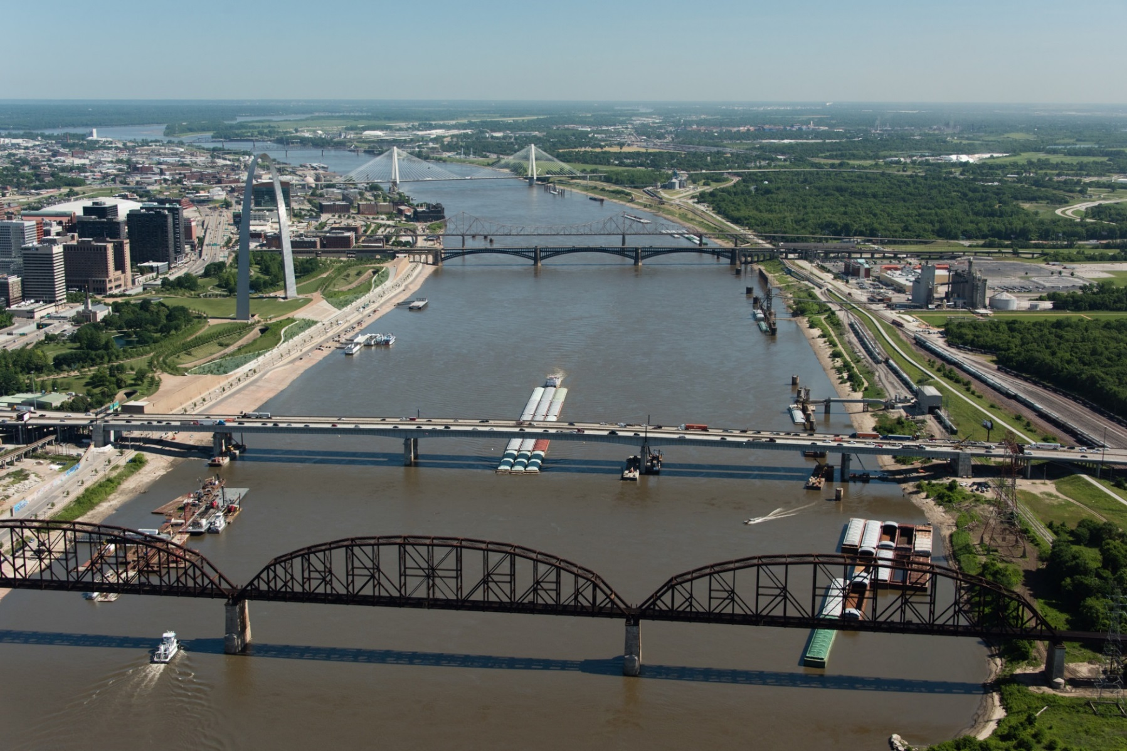
St. Louis Region
National Recognition as a Leader in Transportation
Job-Ready Workforce
  Largest manufacturing and logistics workforce in the Midwest
Geographic Advantage
  The multimodal crossroads of the nation
Six Class I Railroads
  Nation’s third largest rail hub
Four Interstates
  Low congestion, national reach
Two International Cargo Airports
  With rail access, foreign trade zones and available land
World-Class Inland Port System
  Third largest and most efficient system in the nation
Notes:
Wilmsmeyer
St. Louis Region
National Recognition as a Leader in Transportation

Slide 12
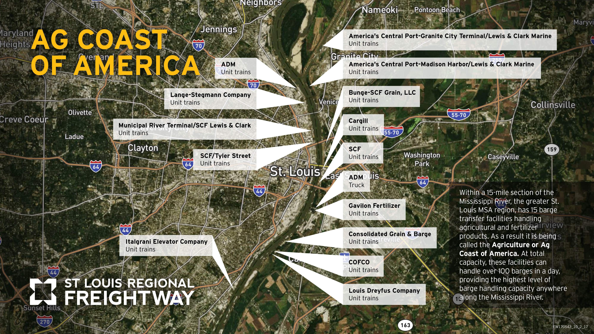
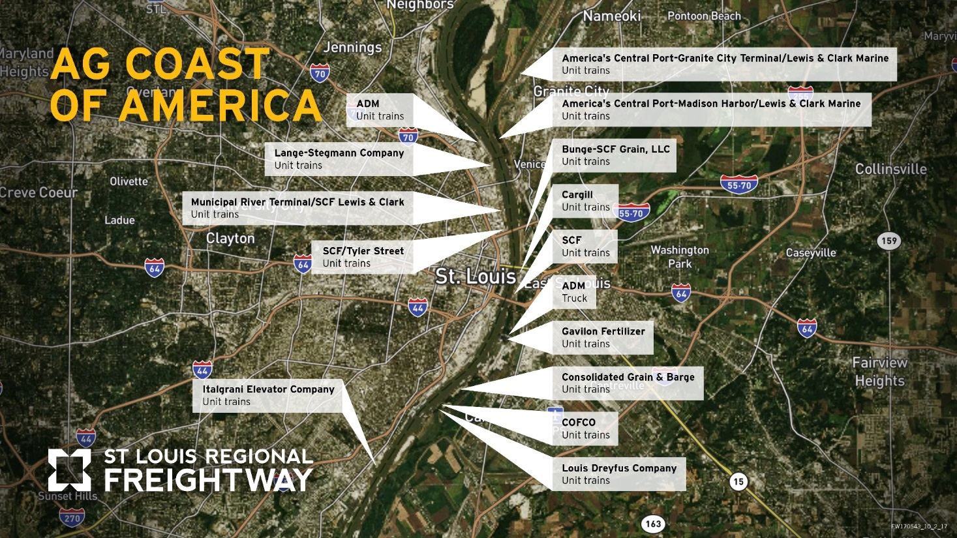
Notes:
Dennis – Competitive Rates – Region offers low-cost competitive rates to barge-loading facilities. Unit trains are cost-saving: 110 – 125 rail cars carrying single commodity, saving time on assembly/disassembly. Growth continues

Slide 13
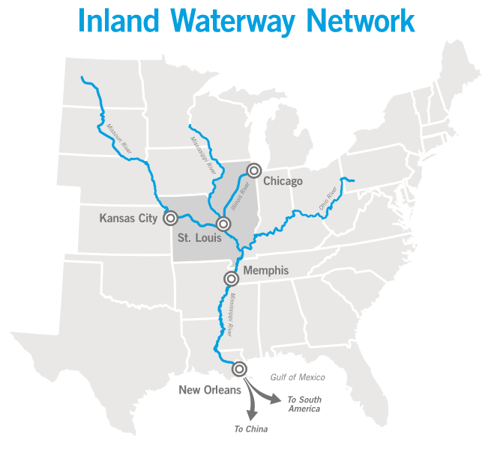
Why the St. Louis Region?
Notes:
Ice free and lock & dam free to and from the Gulf of Mexico
· Four public ports and over 100 privately owned barge transfer facilities
· Three ports have COB capabilities
· ACP MARAD demonstration project to move containers on barge through Madison Harbor.
· USACE - Most efficient inland port system based on tonnage per mile
· Ag Coast of America largest ag and fertilizer barge handling capacity
· Results in low barge rates, excess barge capacity supported by a world class freight network

Slide 14
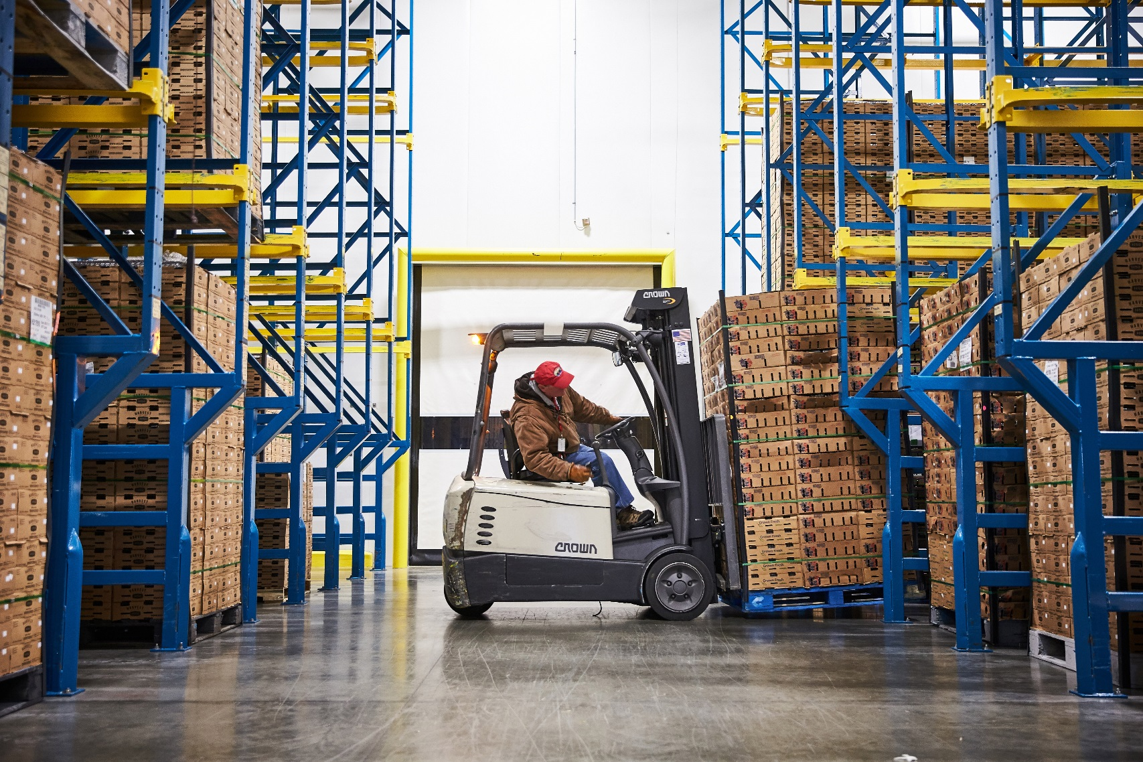
Commodities that can withstand additional transit time:
Metal scrap
Tires
Construction supplies
Appliances
Automotive parts
Specialized grain
Fabricated steel
Seasonal outdoor furniture
Animal feed

Slide 15


Sal Litrico
Chief Executive Officer
American Patriot Holdings LLC

Slide 16

Sandy Sanders
Executive Director
Plaquemines Port Harbor &
Terminal District

Slide 17
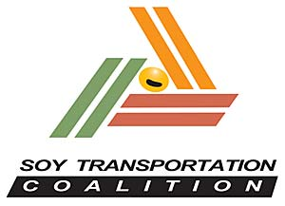

Mike Steenhoek
Executive Director
Soy Transportation Coalition

Slide 18
Anti-Trust Statement
There shall be no discussion of activities for the purpose of arriving at any understanding or agreement regarding price, the terms or conditions of sale, distribution, volume of production, territories or customers.
There shall be no discussion or activity for the purpose of preventing any person or persons from gaining access to any market or customer for goods or services, nor any agreement or understanding to refrain from purchasing or using any material, equipment, services or supplies.
There shall be no discussion or activity that may be construed as forestalling or limiting research and development.
We request your consideration and full compliance with these guidelines while in attendance of today’s meeting.

Slide 19
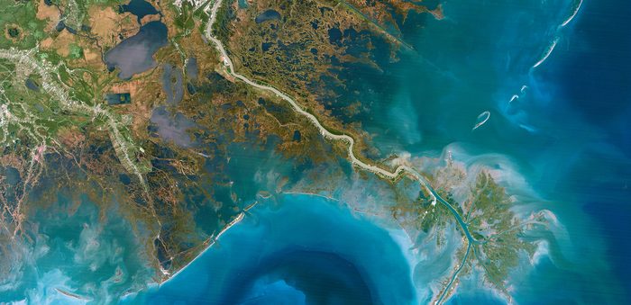
APH & PPHTD:
Innovation:
Global Trade and Inland Waterways
A New Paradigm in International & Domestic Freight Movement
STL Regional BCO/Shipper/Freight Forwarders Meeting - August 30, 2018

Slide 20


Global Maritime Trade to
Double by 2030
Significant growth in world trade projected in next 10 years
Doubling of seaborne trade volumes
Trade to grow from 10 Billion Tons to 20 Billion Tons by 2030
Source: Danish Maritime Forum, 24-28 October 2016

Slide 21
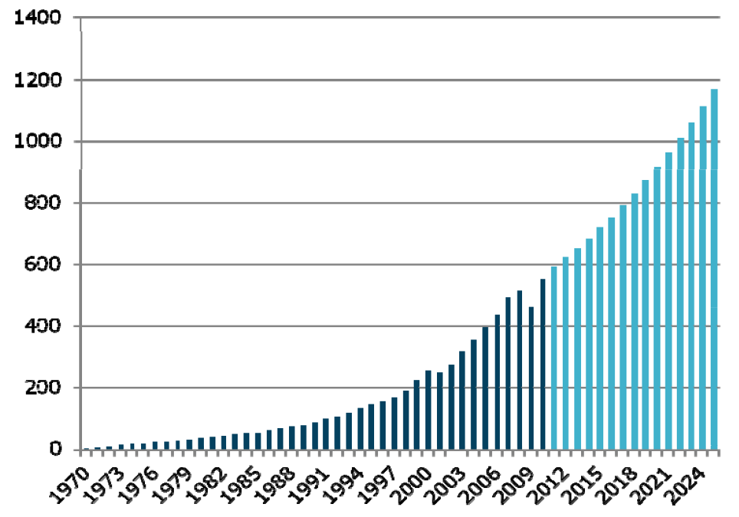
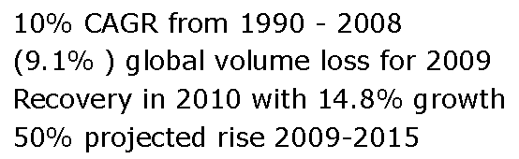
2025 World Container Port Market Demand
260%
Increase
2009 Recession
Millions of TEUs
Source: Drewry Shipping Consultants

Slide 22
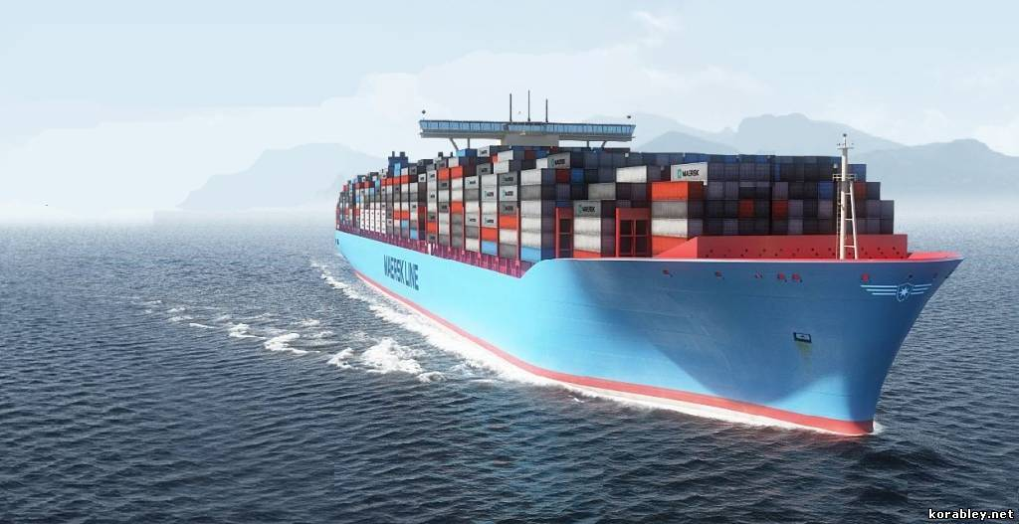
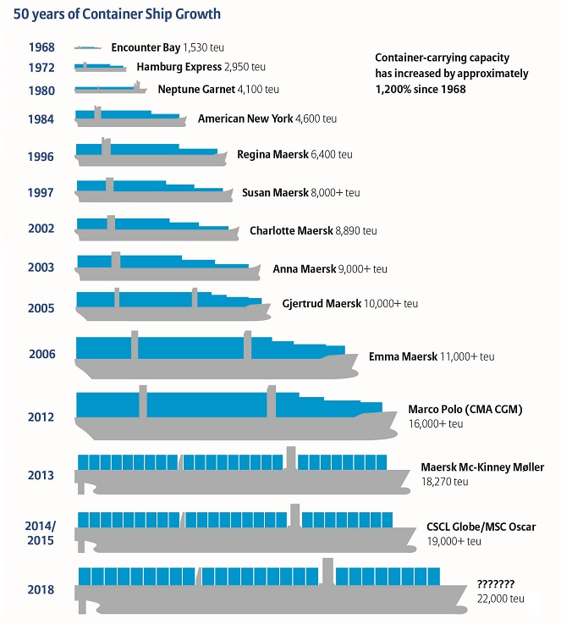
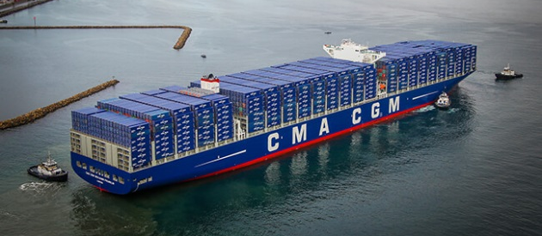
50 Years of Container Vessel Evolutionary Growth
Old Panamax:
4,800 TEUs
Neo-Panamax:
14,800 TEUs
Near Term
Mega Vessel:
24,000 TEUs
Source: Allianz Global Corporate & Specialty - Data: Container-Transportation.com

Slide 23
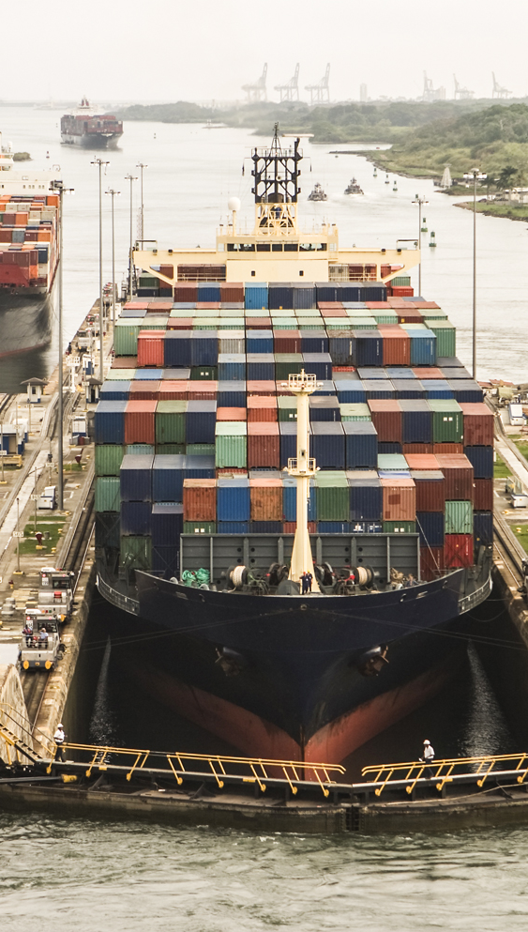
Historical Trade Patterns
Pre-Panama Canal Expansion
    Gulf Coast Ports handled 6.4% of total U.S. container volume
Mid-West Represents 40% of U.S. Land Area
    15% of U.S. GDP
    92% of the U.S. agricultural exports
    60% of U.S. grain exports
    Approximately 200 million metric tons of exports
Pre-Panama / Suez Canal Expansions – Mississippi Watershed Trade
    Majority shipped through West Coast Ports

Slide 24
Post Panama / Suez Canal Expansions
Canals Handling Larger Vessels
  Panama Canal now handing up to 18,000 TEU vessels
    Beam limit 51.25 Meters as of June 1, 2018
  Suez Canal has no existing limits on vessel size
  Larger vessels have inherent cost efficiencies
Additional Sailing Time to Gulf Coast Offset by Growing West Coast Delays
Gulf Coast Ports “Market Share” of U.S. Container Trade Up to 8.48% in 2017
  U.S. Container market share increased from 9.5% to 11.9%

Slide 25
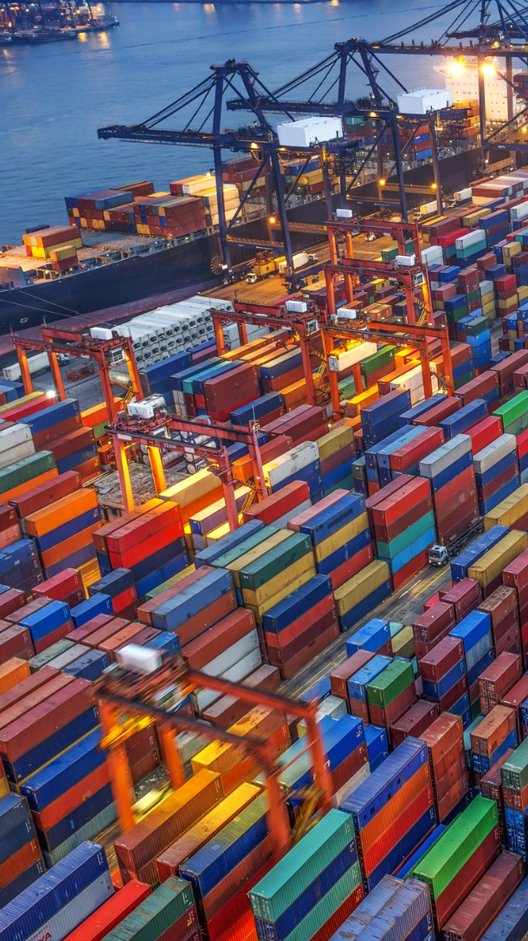
Recent Shifts in Trade Patterns
Ocean Carrier Alliances = Fewer / Larger Vessels
  Pooling assets / slots to improve vessel utilization
  Expectation - terminals will improve productivity
Existing Gulf Coast Ports Have Inherent Inefficiencies:
  Originally built for smaller vessels
  Have limited expansion capability
  Growing dwell times and intermodal delays

Slide 26
Why a New Mid-America Logistic System is Required
Mid-America Lacks a Fundamental and Efficient Supply Logistic System
  Freight volumes to and from Mid-America are increasing
  There is no true or efficient Mid-America gateway port
  There is a growing demand for increased commodity containerization
  There is a growing demand for containerized AG product export
  The imbalance of trade results in a high demand for efficient repositioning of empties
Larger Ocean Carrier Deployments to U.S. Result in Fewer Port Calls with Higher Volumes
  Significant impacts to terminal production
  Increased import / export dwell times
  Increased time allocations for dray gate movements

Slide 27
Why a New Mid-America Logistic System is Required
Impacts of Changing Logistic Systems on Existing Gateway Terminals are Negatively Impacting Shippers
  Increasing terminal handling costs and surcharges
  Reliability issues
  Tracking and transparency issues
  Growing congestion of public roadways and negative public reaction
Intermodal / Drayage Impacts with Growing Container Volumes
  Slower intermodal times
  Chassis capacity problems
  Truck drivers timing out (EDL)
  Difficulty in hiring qualified new Truck/Rail employees
  Last mile emphasis

Slide 28
APH / PPHTD Transportation Alternative

Slide 29
APH / PPHTD Transportation Alternative
  New Gulf Coast Gateway Port: Plaquemines Port Harbor and Terminal District (PPHTD) at Mile 55
      PPHTD is southern most container terminal on Mississippi River
      Less marine traffic congestion
      50% less ocean carrier navigation time
      No bridge impediments to terminal
      Deepest water and widest part of the river

Slide 30
APH / PPHTD Transportation Alternative
  Terminal:
      Capable of servicing the largest ocean carriers (20,000+ TEU)
      Shippers option for all inter-modal transportation, including Marine
      Modern terminal technology expedites container throughput
  Combined Benefits – PPHTD and APH:
      Substantial “Landed Transportation Cost Savings” for Mid-America shippers
      Improved reliability
      Enhanced operational safety and reduced environmental impact

Slide 31
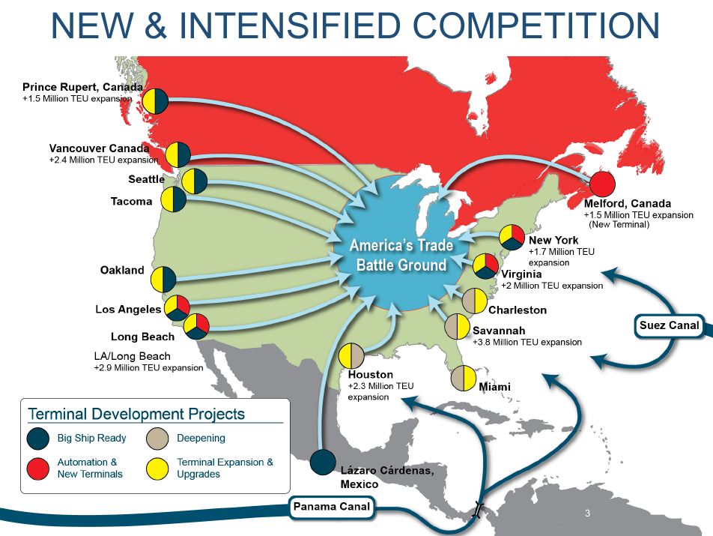

Mid-West Battleground
Mid-West Battleground
Source: NW Seaport Alliance Strategic Business Plan, May 6,2015

Slide 32
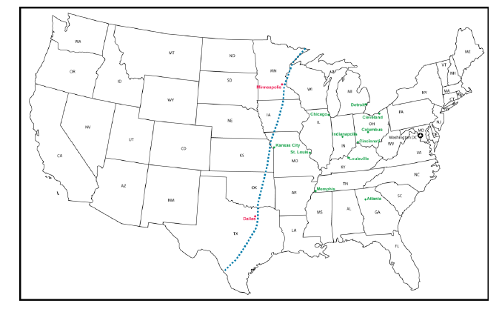
Dramatic Market Penetration – Post-Panama Canal Expansion
East/Gulf Coast
Cost Advantage
West Coast
Cost Advantage
Cost Advantage Area
West of the MS River
PRE PANAMA CANAL EXPANSION
Source: Texas DOT, Cambridge Systemics

Slide 33
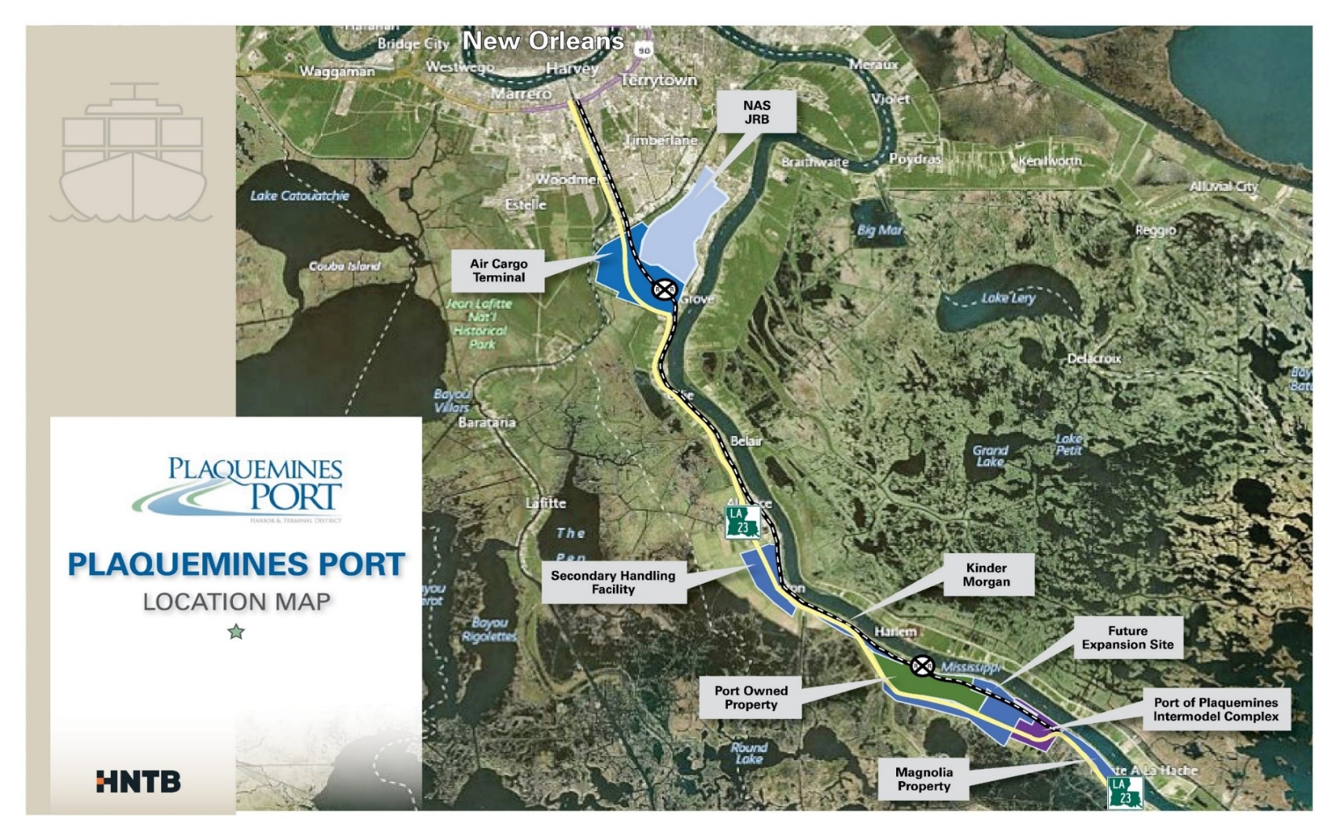
Mississippi River- Plaquemines Port

Slide 34
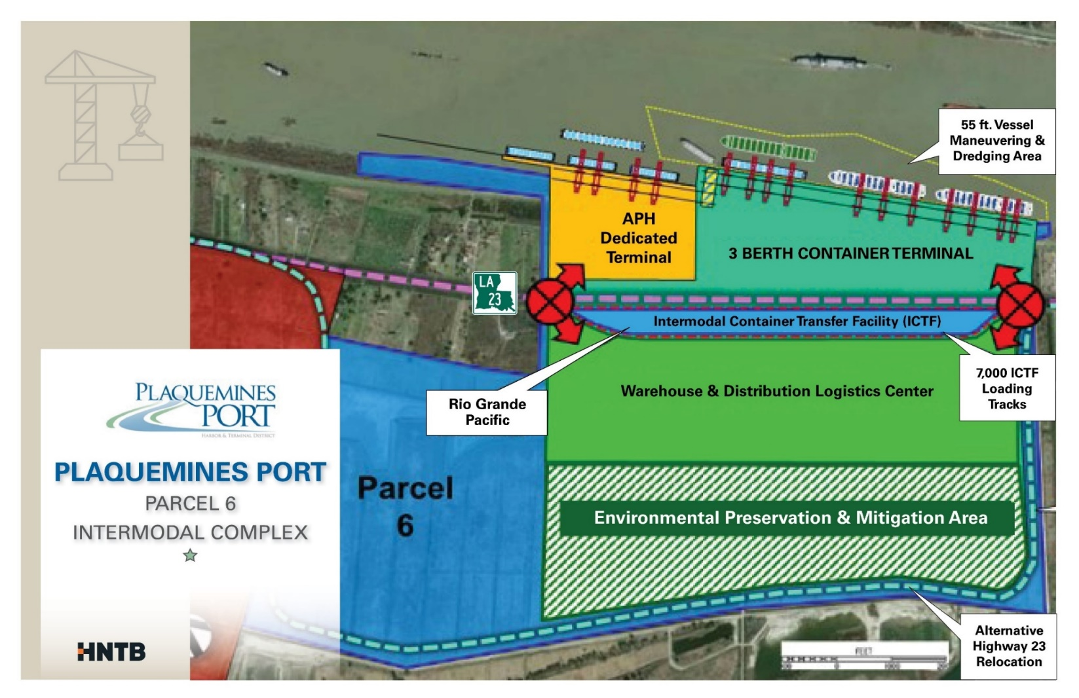
PPHTD Container Terminal Plan
PPHTD Container Terminal Plan

Slide 35
APH / PPHTD Transportation Alternative
State of the Art Gateway Terminal (Full Intermodal)
Capable of servicing 20,000+ TEU vessels
Best of class productivity
No legacy labor work rules
On dock inter-modal transfers
Best of class gate technology with high capacity lanes
On dock transfer to economically competitive inland river transportation mode
Adjacent logistics park for consolidation, de-consolidation, cross dock, distribution, value add FTZ applications
Adjacent commercial air cargo facility
Strategic upriver consolidation and de-consolidation locations
Empty container repositioning transfer
Ocean Carrier support

Slide 36
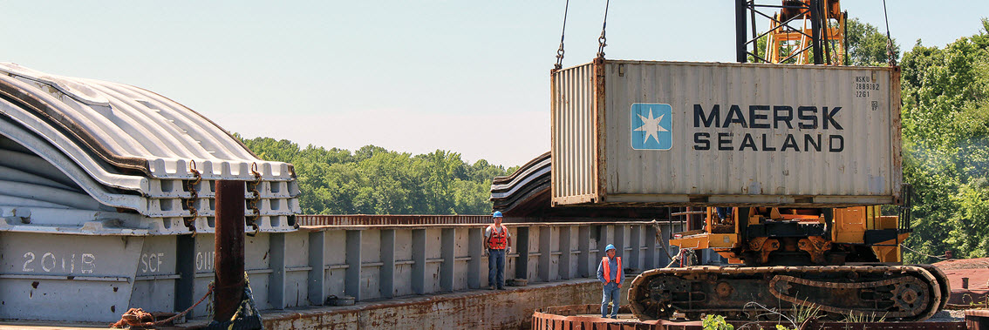
Conventional Container On Barge Operations
Loading and Unloading-Conventional Cranes Utilizing Hopper Barges
Inherent Operational Shortcomings:
Hopper barge stability issues with high loads
Limited cargo payload capacity
Conventional speed underway (4-5 mph) and low capacity cranes
Potential barge breakaways
Navigation requires “flanking” in turns

Slide 37
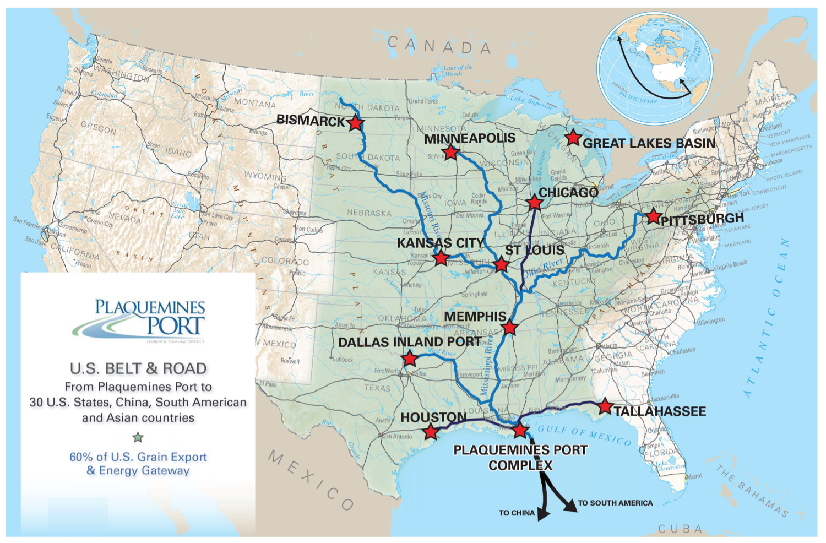
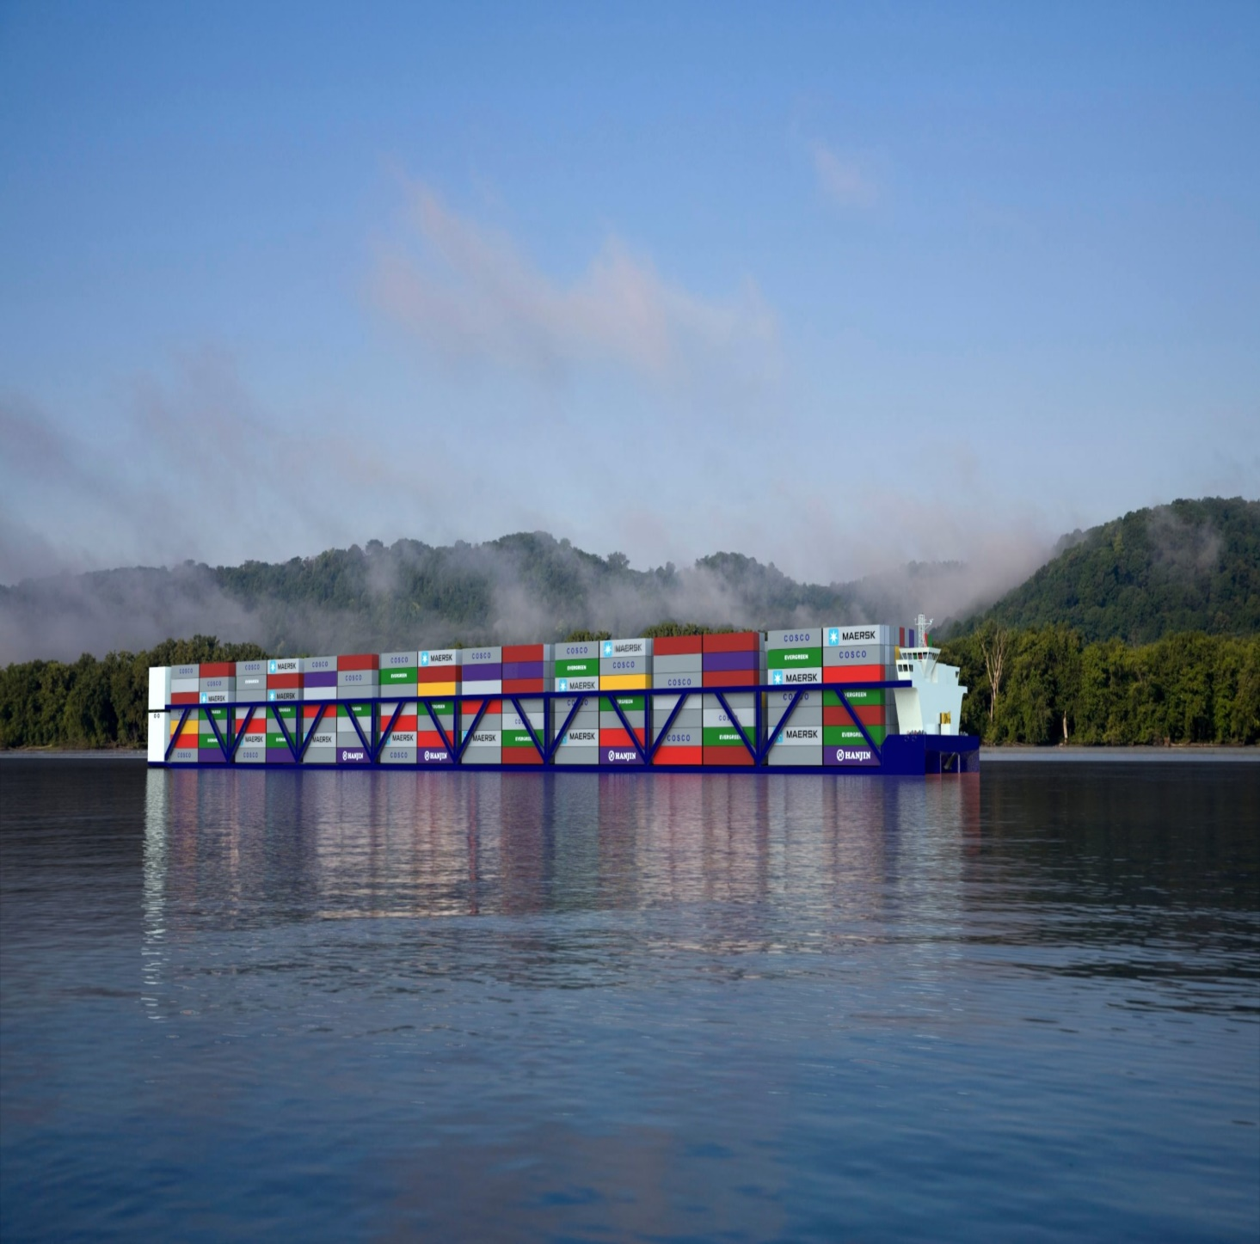
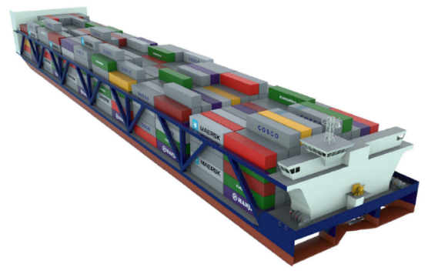

American Patriot Holdings Strategic Waterway Footprint

Slide 38
APH Key Drivers for Success
  The “Gift” is the Significant Natural Waterway System to Mid-America
    Problem recognized : commerce has been conducted in much the same way over 70 years
  The “Challenge” was to Design a Container Vessel to Meet or Exceed Six Major Elements Necessary for Success:
        Reliability
        Cost Efficiency
        Speed
        Cargo Payload
        Safety and Environmentally Friendly
        Cargo Flexibility

Slide 39
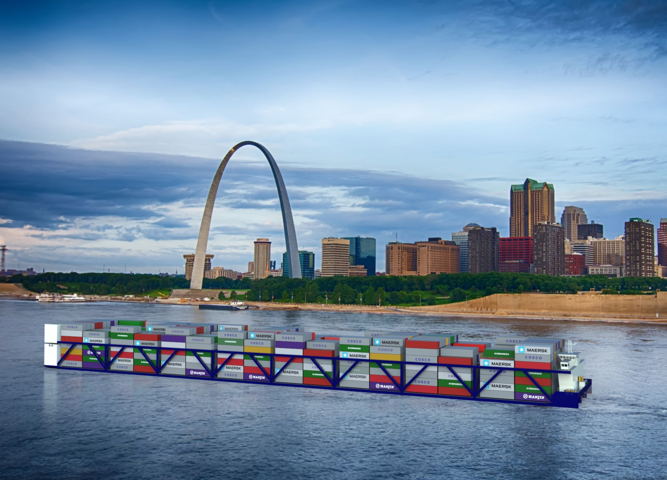
American Patriot Holdings Self Propelled Vessel

Slide 40
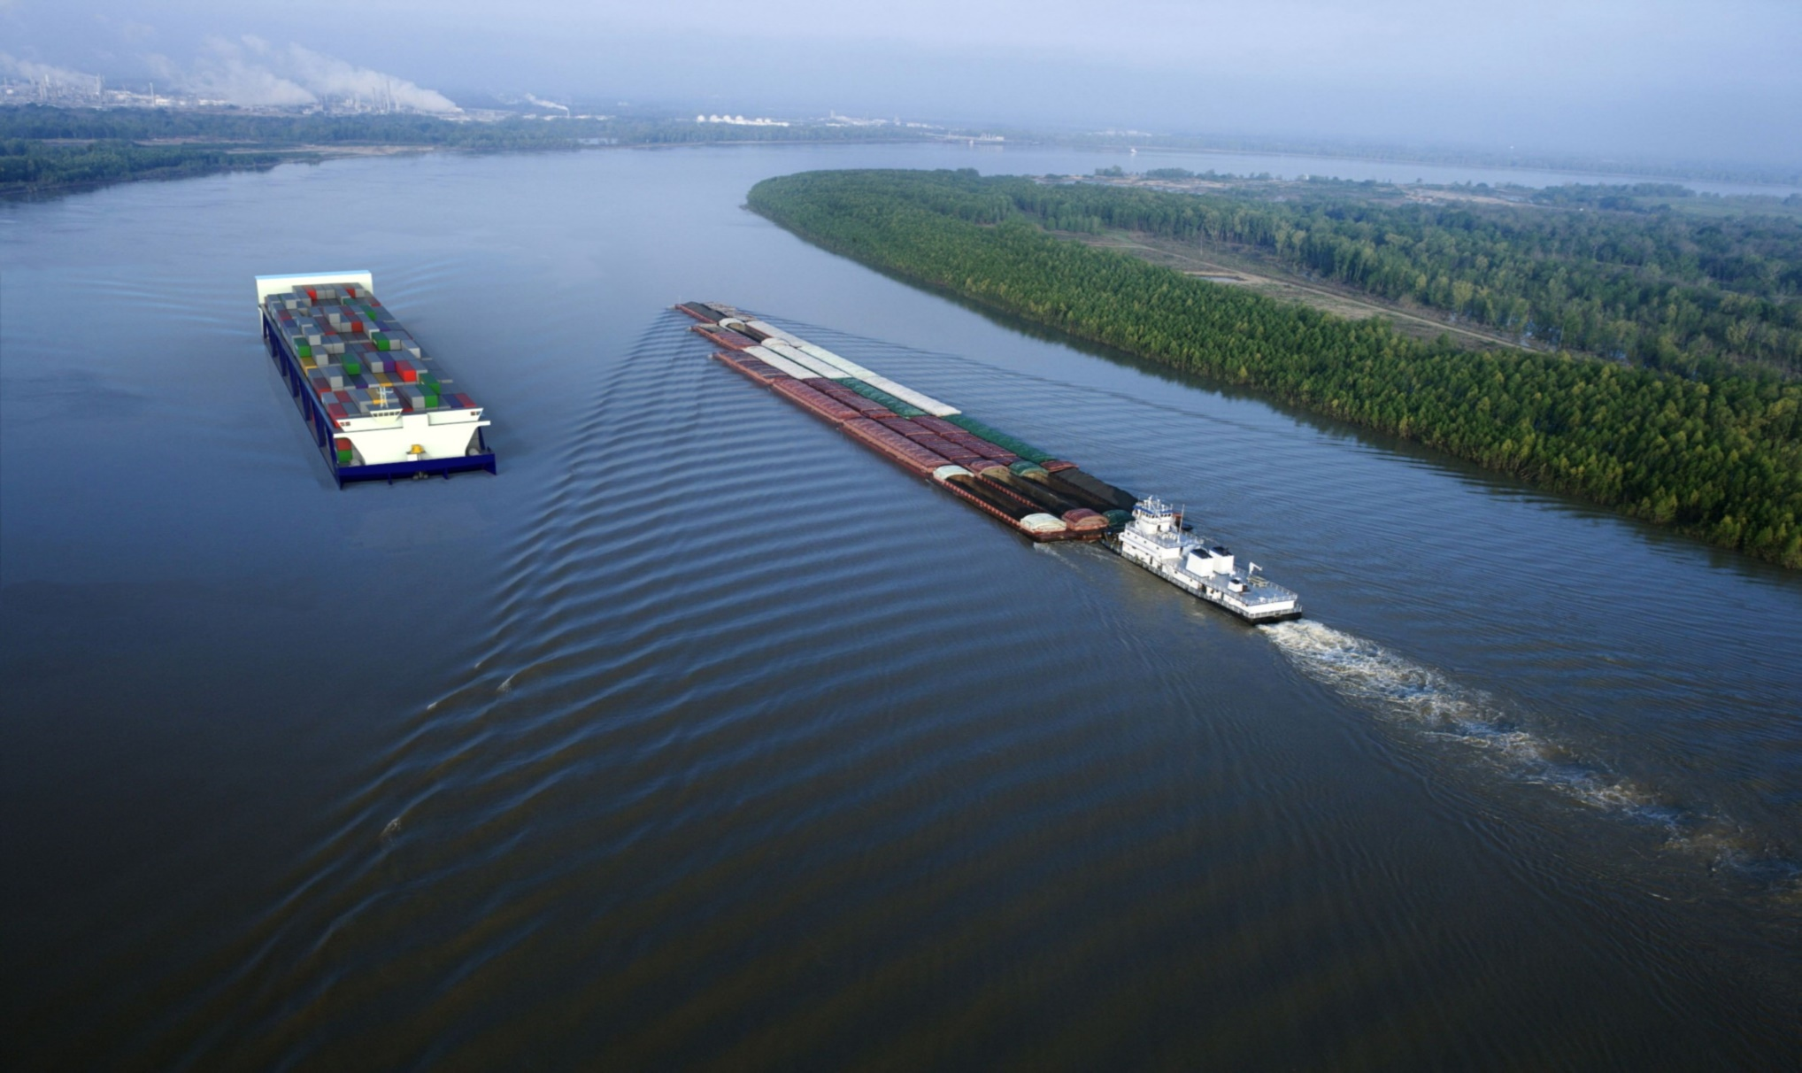
Liner Design Specifications
Mississippi River Service
Length Overall | 595+ ft. | Ballast Tanks | Eight (8)
Beam | 134 ft. | Fuel | LNG
Height Above Water | 48 ft. at 9’ Draft | Fuel Capacity | 1000cm (3 trips)
Speed (Upriver) | 13 MPH | Power Plant | Diesel Electric
Operating Draft | Up to 10 ft. | Main Generators | Four (4) – 2880 kW each
DWT | 12.7k - 14.8k LT (9-10’ Drafts) | Horsepower | 14,850
TEU Capacity | 2500 | Propulsion Drives (Stern) | Three (3) Drives
Reefer TEU Capacity | 500+ Electric power as needed | Bow Drives | Two (2) (1000kw Each)
Crew Size | Expect 10-12 | Deck Machinery | Electric
Trading Range | Mississippi River | Gross Registered Tons | > 10,000

Slide 41
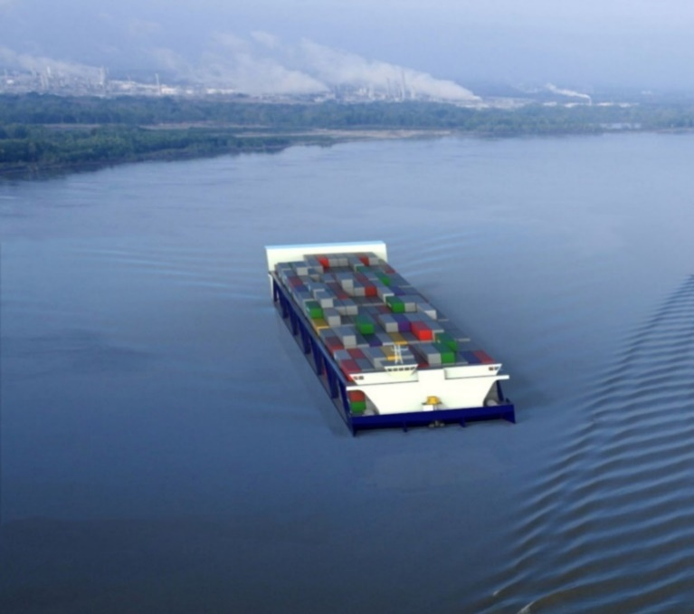
Hybrid Design
Specifications
Tributary River—
Above Locks
Length Overall | 595 ft. | Ballast Tanks | Eight (8)
Beam | 100 ft. | Fuel type | LNG
Height Above Water | 42 ft. at 9’ Draft | Fuel Capacity | 3 trips
Speed (Upriver) | 13 MPH | Power Plant | Diesel Electric
Operating Draft | Up to 10 ft. | Main Generators | Three (3) 2880 kW each
DWT | 9000+ LT | Horsepower | 11,600
TEU Capacity | 1800+ | Propulsion Drives (Stern) | Three / Four Drives
Reefer TEU Capacity | 300+ Electric Power as Needed | Bow Drives | Two (2) 750kW each
Crew Size | Expect 10-12 | Deck Machinery | Electric
Trading Range | Tributary Rivers | GRT | TBD

Slide 42
Container On Vessel Competitive Advantage
  State of the Art Vessels
      Exoskeleton Hull (Patent) - optimizes cargo payload
      Minimum Resistance Bow (Patent) - optimizes speed / minimizes wake
      Upriver speeds of 13 MPH vs 4-5 MPH against head current
      Propulsion drives coupled with DP eliminates need for flanking
      Parallel docking / undocking without assist tugs
      State of the art navigational tools for improved navigation
      Automation facilitates unattended engine spaces
      Environmental features (no wake, low emissions, no hydraulics on deck)
      Ability to turn in own length
      Redundant propulsion and take me home power

Slide 43
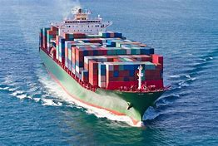

APH / PPHTD Gulf Gateway Terminal
Proven Pre-Feasibility Commercial
Viability Study
APH Inland Carrier
“Offering Shippers New Flexibility – Lower Cost via All Water Routing utilizing the U.S. Marine Super-Highway”
Ocean Transhipment

Slide 44
Marketing / Competitive Edge

Slide 45
Project Pre-Feasibility Study
Study commissioned to determine economic competitiveness of servicing the Mid-America from PPHTD / Container on Vessel vs. Inter-modal from West Coast, East Coast and other Gulf Coast Ports
Study Evaluated:
All container imports / exports for states adjoining the Mississippi River
The “Landed Cost” from Rotterdam and Shanghai to Chicago, St. Louis and Memphis
The “Landed Cost” from PPHTD to upriver cities via rail, truck and APH vessels

Slide 46
Project Pre-Feasibility Study
Study Conclusions:
Significant transportation cost savings result from the PPHTD / APH all water routing alternative
Shippers would welcome a reliable alternative to existing congested gateway ports
Project offers a Value Proposition sufficient to attract ocean carriers, shippers, investors, terminal operators and upriver sister ports
Sufficient cargo demand on tributary rivers requires APH “Hybrid Design” vessels for above the locks service

Slide 47
STC / ISA Study Results

Slide 48
STC / ISA AG STUDY- Informa Economics
Major Objective:
  Evaluate competitiveness of grain exports via PPHTD / APH all water route to Asian Markets vs. current inter-modal West Coast pattern
  Test economics from major agricultural consolidation locations adjacent to Mississippi, Illinois, Missouri and Arkansas Rivers
Conclusions:
  Significant savings results from all water routing of containerized grains
  Longer trade routing Asia to PPHTD offset by significant West Coast delays
  New system should increase demand for containers vs. bulk shipments
    Cost competitive with less contamination and damage
Next Steps:
  Establish STC / PPHTD / APH working group
  Hold Farm COOP / Other BCO meetings
    Kansas City 8/10/18; St. Louis late August 8/29-30/18; Memphis Sept

Slide 49
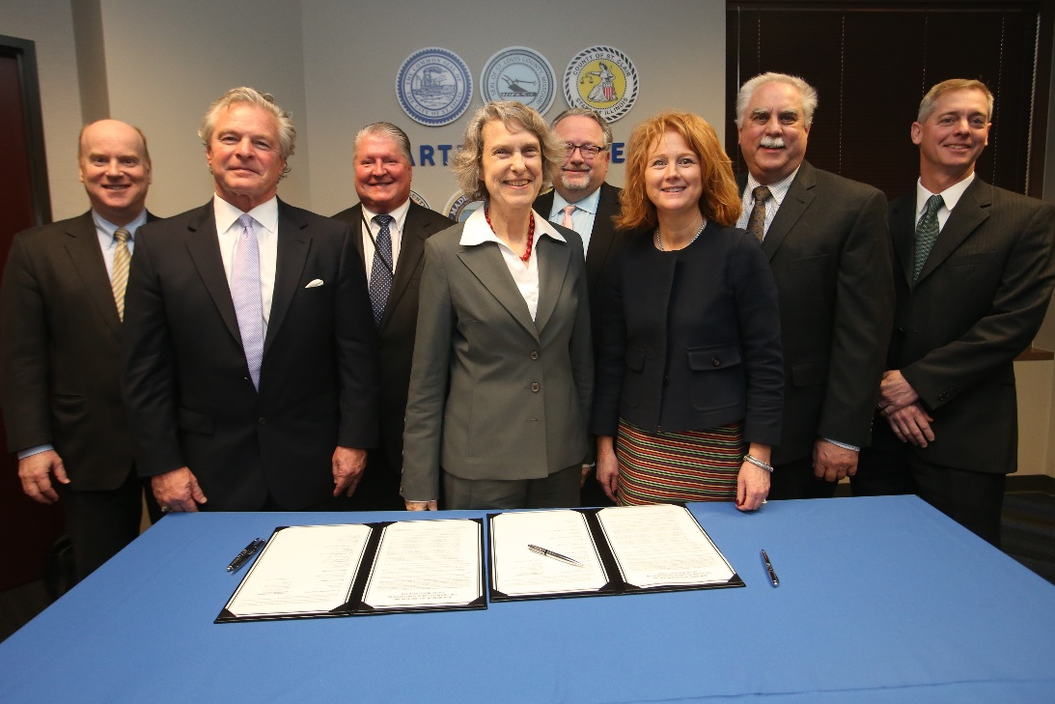
  PPHTD / APH - Partnering with Mid-West
  Ports Through Memorandums of Understanding
  St. Louis Region
  Kansas City
  Memphis
  Cairo
  (Little Rock)
  (Jefferson City-Mo.)
  (Joliet)

Slide 50
Competitive Pricing vs Inter-Modal
COMPETITIVE TRANSPORTATION VS INTER-MODAL: Asia Markets (% Saving with APH)
Exports via Rail to LA/LB vs. All Water Routing APH to Plaquemines
Transportation Savings from Memphis - 30+ %
Transportation Savings from Saint Louis - 30+ %
Transportation Savings from Kansas City - 30+ %
Imports via LA/LB rail to Mid-West vs. All Water Routing Plaquemines and APH
Transportation Savings to Memphis - 40+ %
Transportation Savings to Saint Louis - 40+ %
Transportation Savings to Kansas City - 40+ %

Slide 51
Project Next Steps
  Sign LOI’s With Ocean Carriers, BCO’s, Investors
  PPPHTD
    Finalize Terminal Equity Partners
    Select Terminal Operator(s)
  APH
    Finalize ABS Approvals
    Finalize Design Specifications For Liner and Hybrid
    Obtain Shipyard Construction Bids
  Sister Ports
    Finalize Upriver Terminal Design Criteria
    Conduct Regional BCO / Farmer Meetings
  Strategic Partnerships
    STC / PPHTD/ APH Working Group

Slide 52
Want to Explore The New Mid-America Transportation Option ?
Let’s Meet Individually to:
  Discuss and understand your specific import/export requirements
    volumes, weights, seasonality, ratability, etc.
  Demonstrate the competitiveness and reliability of the All-Water routing of imports / exports to and from Mid-America
  Jointly develop a plan to work together in “partnership” to ensure long term logistic competitiveness and mutual success
  For more information, please visit our Website: AmericanPatriotHoldings.com

Slide 53
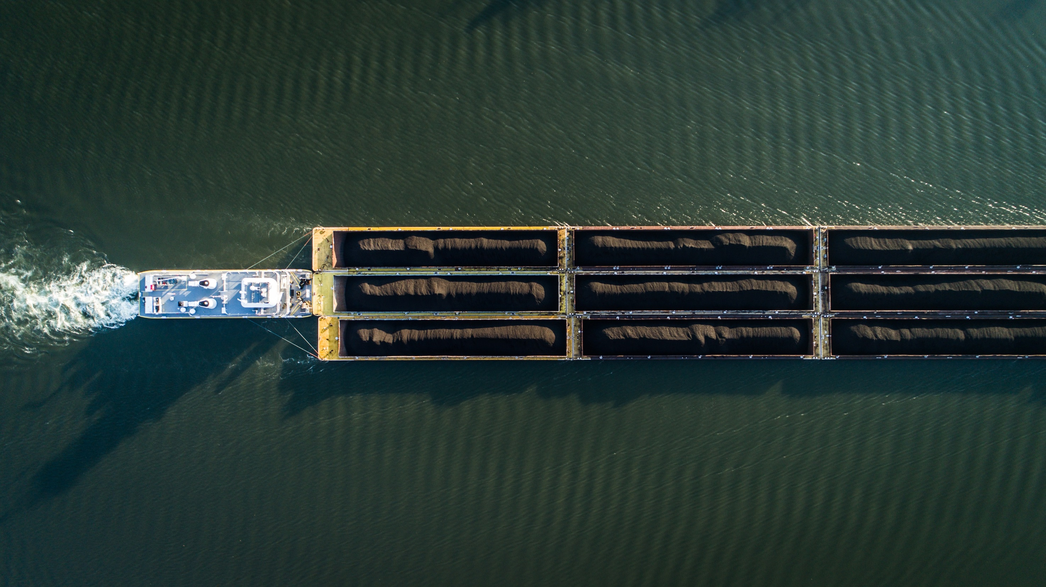

Thank You

